Slide 1
BASIC ELECTRICAL ENGINEERING
UNIT- II
DC GENERATORS & DC MOTORS
By
M. Bhagya Lakshmi
Assistant Professor,
Department of EEE.
G. Pullaiah College of Engineering and Technology
Kurnool – 518452, Andhra Pradesh, India

Slide 2
(i) DC Generators
Principle of Operation of DC Generator
Constructional Details of DC Machine
EMF equation of DC Generator
Types of Generators, Problems
O.C.C (or) Magnetization Characteristics of DC Shunt Generator

Slide 3
Principle of DC Generator
Converts mechanical energy into electrical energy.
A generator works on the principles of Faraday’s laws of electromagnetic induction
Principle: “Whenever a conductor is moved in the magnetic field , an e.m.f is induced and the magnitude of the induced e.m.f is directly proportional to the rate of change of flux linkage. This e.m.f causes a current flow if the conductor circuit is closed “.
The essential components of a generator are:
(a) a magnetic field
(b) conductor or a group of conductors
(c) motion of conductor w.r.t. magnetic field
The direction of induced e.m.f. (and hence current) is given by Fleming’s right hand rule.

Slide 4
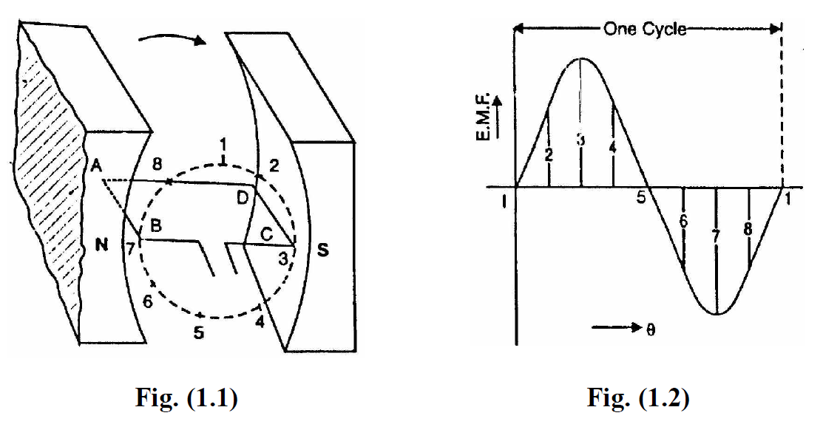
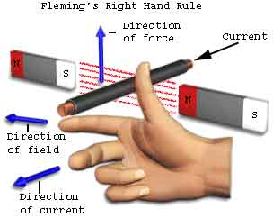
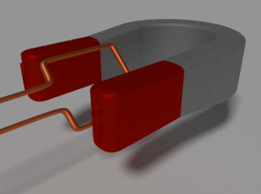
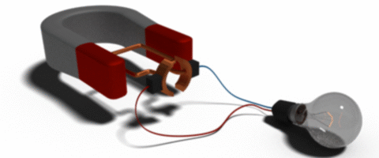
Principle of operation of DC Generator

Slide 5
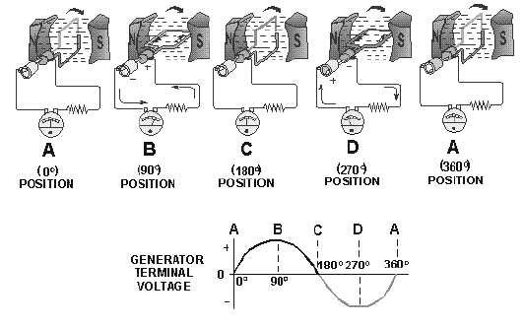

Slide 6
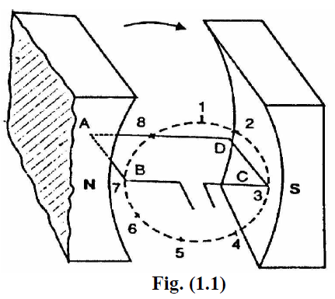
D.C. Generator Principle
An electric generator is a machine that converts mechanical energy into electrical energy. An electric generator is based on the principle that whenever flux is cut by a conductor, an e.m.f. is induced which will cause a current to flow if the conductor circuit is closed. The direction of induced e.m.f. (and hence current) is given by Fleming’s right hand rule. Therefore, the essential components of a generator are: (a) a magnetic field (b) conductor or a group of conductors (c) motion of conductor w.r.t. magnetic field.
Consider a single turn loop ABCD rotating clockwise in a uniform magnetic field with a constant speed as shown in Fig.(1.1). As the loop rotates, the flux linking the coil sides AB and CD changes continuously. Hence the e.m.f. induced in these coil sides also changes but the e.m.f. induced in one coil side adds to that induced in the other.
(i) When the loop is in position no. 1 [See Fig. 1.1], the generated e.m.f. is zero because the coil sides (AB and CD) are cutting no flux but are moving parallel to it.

Slide 7
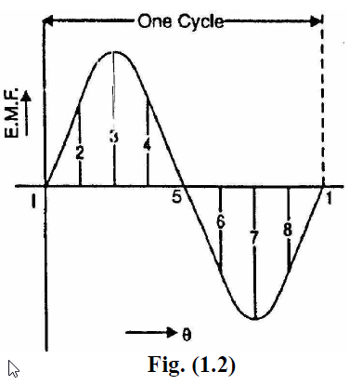
(ii) When the loop is in position no. 2, the coil sides are moving at an angle to the flux and, therefore, a low e.m.f. is generated as indicated by point 2 in Fig. (1.2).
(iii) When the loop is in position no. 3, the coil sides (AB and CD) are at right angle to the flux and are, therefore, cutting the flux at a maximum rate. Hence at this instant, the generated e.m.f. is maximum as indicated by point 3 in Fig. (1.2).
(iv) At position 4, the generated e.m.f. is less because the coil sides are cutting the flux at an angle.
(v) At position 5, no magnetic lines are cut and hence induced e.m.f. is zero as indicated by point 5 in Fig. (1.2).
(vi) At position 6, the coil sides move under a pole of opposite polarity and hence the direction of generated e.m.f. is reversed. The maximum e.m.f. in this direction (i.e., reverse direction, See Fig. 1.2) will be when the loop is at position 7 and zero when at position 1. This cycle repeats with each revolution of the coil.

Slide 8
Note that e.m.f. generated in the loop is alternating one. It is because any coil side, say AB has e.m.f. in one direction when under the influence of N-pole and in the other direction when under the influence of S-pole. If a load is connected across the ends of the loop, then alternating current will flow through the load. The alternating voltage generated in the loop can be converted into direct voltage by a device called commutator. We then have the d.c. generator. In fact, a commutator is a mechanical rectifier.

Slide 9
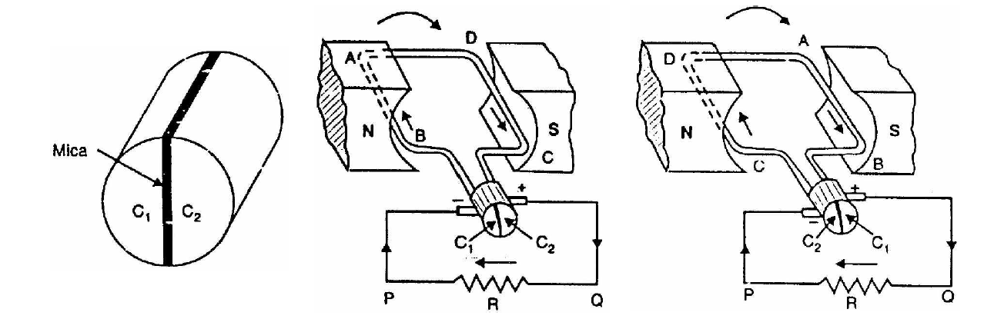
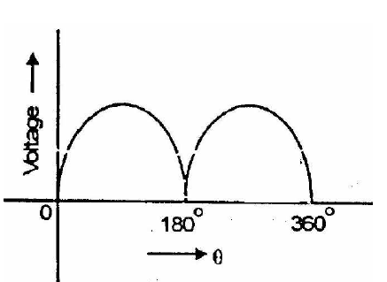
Action of Commutator

Slide 10
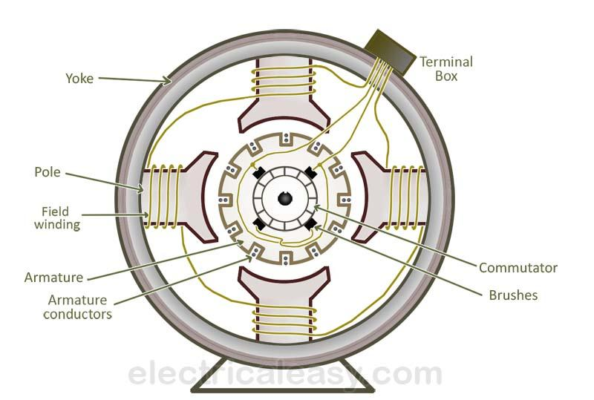
DC Machine Construction

Slide 11
DC Machine

Slide 12
Stator
  Yoke
  Pole Cores, Pole shoes and Inter Poles
  Field windings
  Compensating windings
  Brushes
Rotor
  Armature core
  Armature winding
  Commutator, Shaft

Slide 13
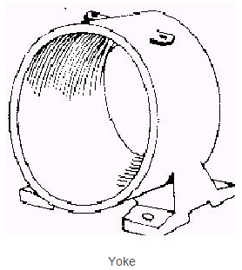
Yoke
Functions:
It provide mechanical Support for poles
It also provide protection to whole machine from dust, moisture etc.
It also carries magnetic flux produced by the poles
Yoke is also called as frame.
Made up of Cast iron or Steel

Slide 14
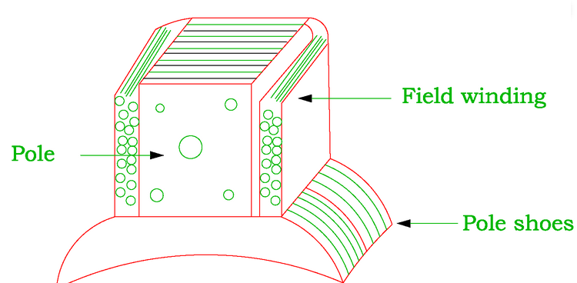
Poles
Pole Core Function:
Pole of a generator is an electromagnet.
The field winding is winding over pole.
Pole provides magnetic flux when field winding is excited.
It is made up of magnetic material like Cast iron or Cast steel
Pole Shoe Functions:
It is extended part of pole. It enlarge area of pole.
Due to this enlarged area, flux is spread out in the air gap and more flux can pass through the air gap to armature.
It is made up of magnetic material like Cast iron or Cast steel

Slide 15
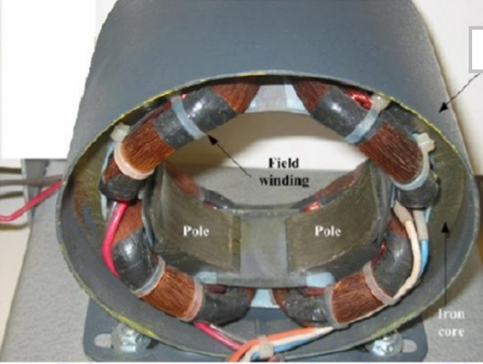
Field Windings
The field winding is wound on the pole core with a definite direction
Functions:
To carry current due to which pole core on which the field winding is placed behaves as an electromagnet, producing necessary flux.
As it helps in producing the magnetic field i.e exciting the pole as an electromagnet it is called Field winding or Exciting Winding
Must be a conducting material – Copper.

Slide 16
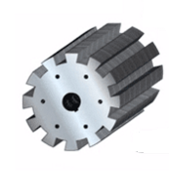
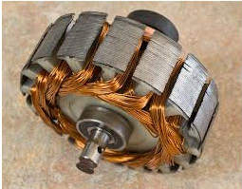
Armature
Armature Core:
It has large number of slots in its periphery
Armature conductor, are placed in this slots
It is also provide path of low reluctance to the flux produced by field winding.
As it has to provide low reluctance path to the flux, it is made up of magnetic material like Cast iron or Cast steel.

Slide 17
Armature Winding
Armature conductors are inter connected to form armature Winding
When armature winding is rotated using prime mover in case of generator, the magnetic flux gets cut by the armature conductors and e.m.f gets induced in them.
Armature winding is connected to external circuit.
As armature winding carries entire current, which depends on external load, it has to be made up of conducting material i.e Copper
Depending upon the way of connecting the armature windings are basically of two types:
Lap winding A=P
Wave Winding A=2

Slide 18
Commutator
Functions:
To facilitate the collection of current from the armature conductor
To convert internally developed alternating e.m.f to unidirectional (D.C) emf .
To produce unidirectional torque in case of motor.
As it collects current from armature, it is also made up of Copper segments.
Brushes
Brushes are stationary and resting on the surface of the commutator.
Function:
To collect current from commutator and make it available to the stationary external circuit.
Brushes are normally made up of soft material like Carbon.

Slide 19
EMF Equation of DC Generator
Let f = flux/pole in Wb
Z = total number of armature conductors
P = number of poles
A = number of parallel paths=2 for wave winding
= P for lap winding
N = speed of armature in r.p.m.
Eg = e.m.f of the generator = e.m.f/parallel path

Slide 20
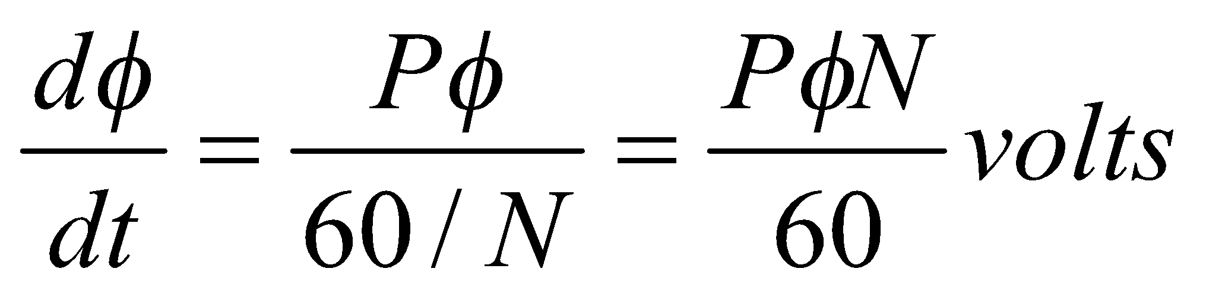
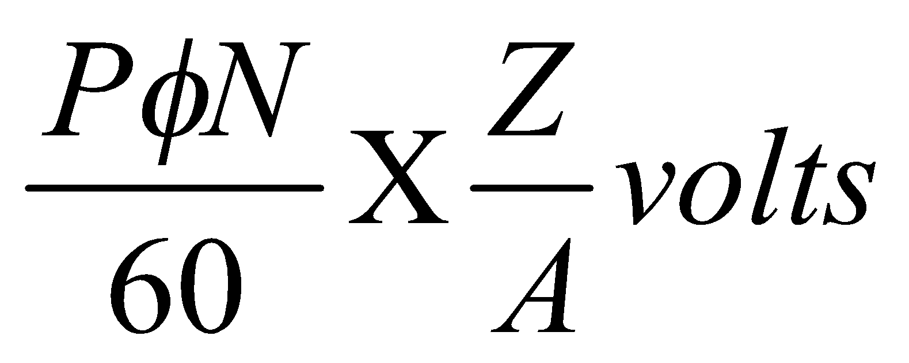
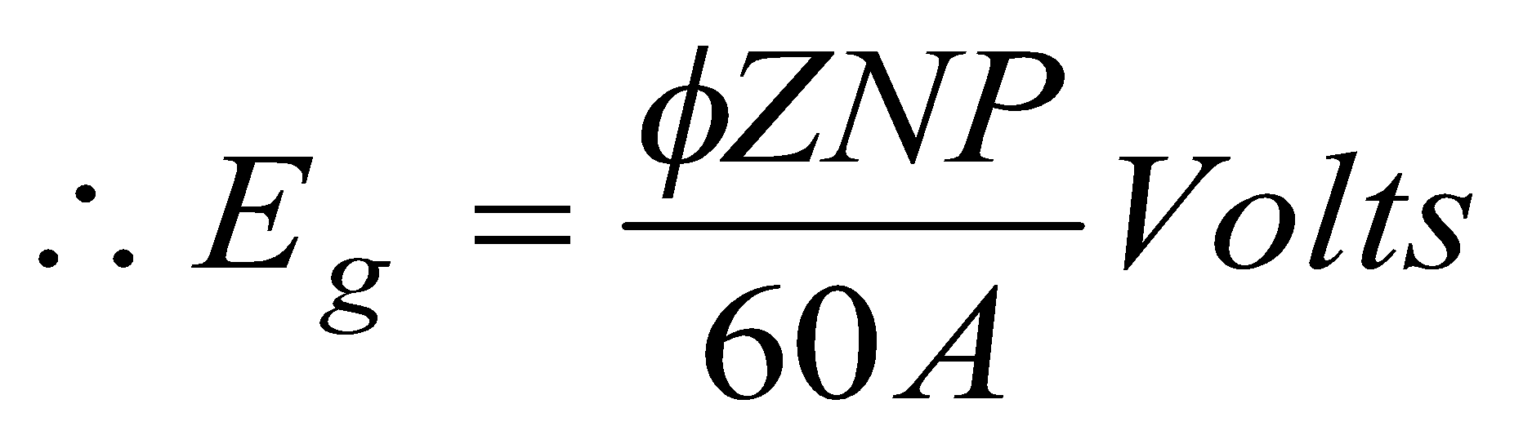
Flux cut by one conductor in one revolution of the armature = dΦ = PΦ webers
Time taken to complete one revolution=dt=60/N second
e.m.f generated/conductor =
e.m.f of generator,Eg=e.m.f. Per parallel path
=(e.m.f/conductor)xNo.ofconductors
in series per parallel path=
where A=2 for wave winding;
= P for lap winding

Slide 21
Types of DC Generators
Separately Excited DC Generators
Self Excited DC Generator
Series Wound
Shunt Wound
Compound Wound
Long Shunt
Short Shunt
C.C D.C
C.C D.C

Slide 22
Separately-excited DC generator: This dc generator has a field magnet winding which is excited using a separate dc voltage source (ex: battery).
Self-excited DC generator : These are the generators in which the field winding is excited by the output of the generator itself. In this machine, residual magnetism must be present in the magnetic circuit of the machine in order to start the self-excitation process.
There are three types of self-excited dc generators
1) Series
2) Shunt
3) Compound

Slide 23
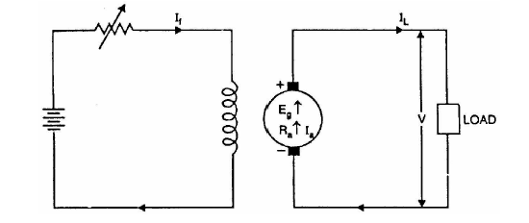
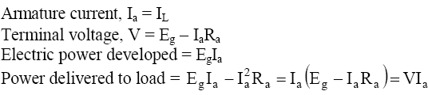
Separately excited D.C. generators
- V_{brush}
where R_{a}= Resistance of armature winding + Resistance of brushes

Slide 24
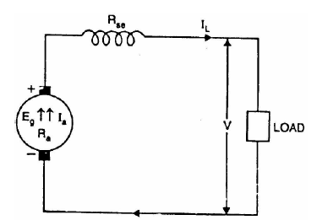
Self – Excited Generators
Series Generator
If a field winding is connected in series with armature winding then it is called a Series Generator.
Applications:
-Series Generators are used as Boosters on DC Feeders in Traction service.
-As lighting arc lamps.
Armature current, Ia = Ise = IL = I
Terminal voltage, V = Eg - I(Ra + Rse) - V_{brush}
Power developed in armature = EgIa
Power delivered to load

Slide 25
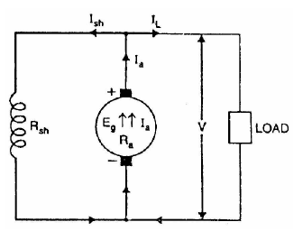
Shunt generator
If a field winding is connected in parallel with armature winding then it is called Shunt Generator.
Applications:
-Shunt Generators are used for ordinary lighting and power supply purposes.
-For charging batteries.
Shunt field current, Ish = V/Rsh
Armature current, Ia = IL + Ish
Terminal voltage, V = Eg – IaRa - V_{brush}
Power developed in armature = Eg.Ia
Power delivered to load = V.IL

Slide 26
Compound Generator
In a compound-wound generator, there are two sets of field windings on each pole—one is in series and the other in parallel with the armature.
(i) Cumulative compound generator - if two sets of field windings(series flux & shunt flux) may be connected to aid with each other is called cumulative compounding.
(ii) Differential compound generator - if two sets of field windings fluxes(series flux & shunt flux) oppose with each other is called differential compounding.
A compound wound generator may be:
(a) Short Shunt in which only shunt field winding is in parallel with the
armature winding.
(b) Long Shunt in which shunt field winding is in parallel with both series
field and armature winding.

Slide 27
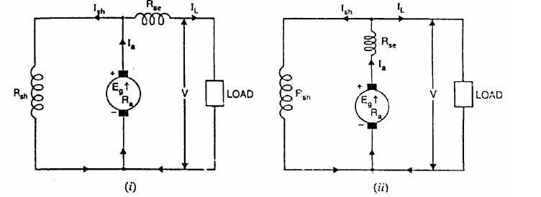

Compound generator
Short Shunt
Long Shunt
Series field current, Ise = IL
Shunt field current, Ish
Terminal voltage,V=Eg-IaRa-IseRse-Vbrush
Power developed in armature = EgIa
Power delivered to load = VIL
Series field current, Ise = Ia = IL + Ish
Shunt field current, Ish = V/Rsh
Terminal voltage, V=Eg-Ia(Ra+Rse)-Vbrush
Power developed in armature = EgIa
Power delivered to load = VIL

Slide 28
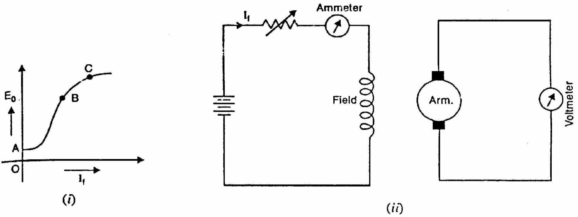
Open Circuit Characteristic (O.C.C.) or Magnetisation Characteristics :
---gives relation between No-load EMF (Eo) and field current (If) at constant speed.
From OCC characteristics we can determine critical field resistance and critical speed.

Slide 29
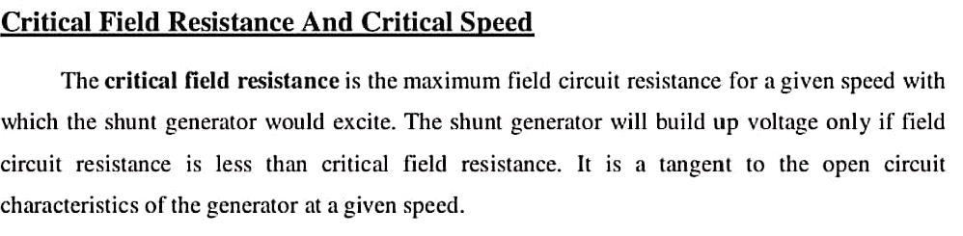
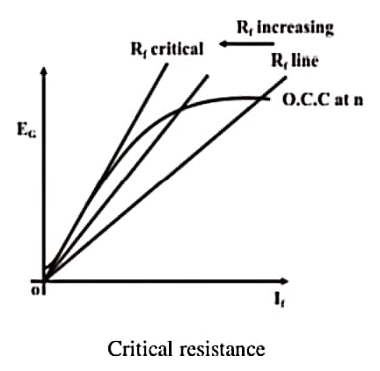

Slide 30
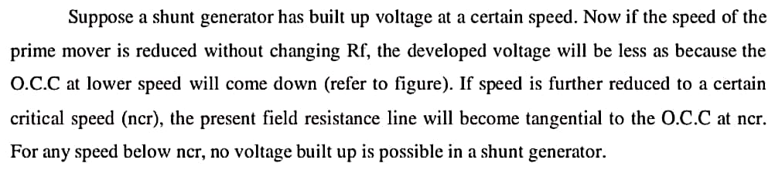
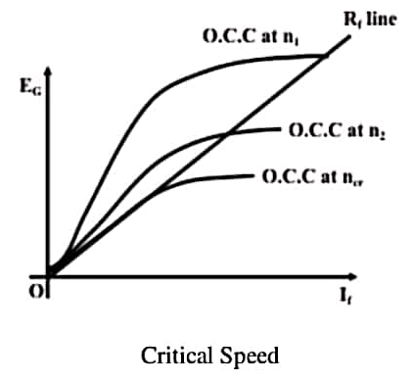
Critical Speed

Slide 31
Critical field resistance: It is defined as the maximum field circuit resistance for a given speed with which the shunt generator would just excite (build up the voltage).
Critical Speed: It is defined as the value of speed below which the shunt generator fails to excite (or fails to build up the voltage).

Slide 32
(ii) DC Motors
Principle of DC Motors
Back EMF and its significance
Types of DC Motors
Torque Equation
Speed Control of DC Shunt Motor- Flux and Armature Voltage control methods
Losses and Efficiency
Swinburne‘s Test

Slide 33
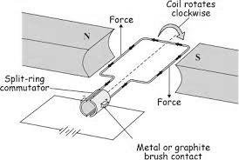
DC MOTOR
A DC motor is a mechanical rotating device which converts electrical energy into mechanical energy. It is based on the principle of force acting on a current carrying wire in a magnetic field.

Slide 34
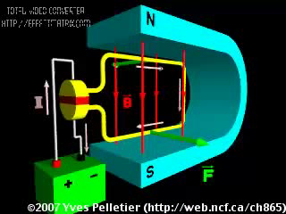
DC Motor Principle
DC motor working is based on the principle that when a current carrying conductor is placed in a magnetic field, the conductor experiences a mechanical force.
The direction of this force is given by Fleming’s left-hand rule and magnitude is given by
F = BIL Newtons

Slide 35
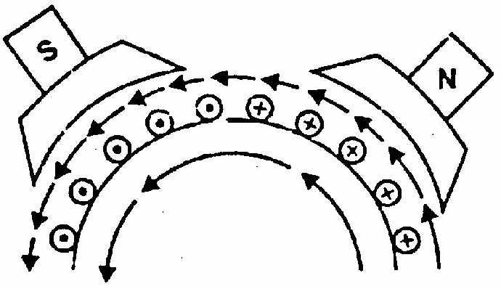
Operation of DC Motor
When the terminals of the motor are connected to an external
source of d.c. supply:
The field magnets are excited
developing alternate N and S poles;
(ii) The armature conductors carry current.
All conductors under N-pole carry
currents in one direction, while all the conductors under S-pole
carry currents in the opposite direction.
Suppose the conductors under N-pole carry currents into the plane of the paper and those under S-pole carry currents out of the plane of the paper.
Since each armature conductor is carrying current and is placed in the magnetic field, mechanical force acts on it.

Slide 36
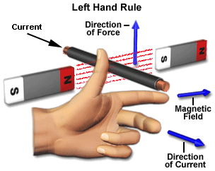
Fleming’s left hand rule
Applying Fleming’s left hand rule, it is clear that force on each conductor is tending to rotate the armature in anticlockwise direction.
All these forces add together to produce a driving torque which sets the armature rotating.
When the conductor moves from one side of a brush to the other, the current in that conductor is reversed and at the same time it comes under the influence of next pole which is of opposite polarity.
Consequently, the direction of force on the conductor remains the same.

Slide 37
Back EMF in DC Motor
When the current carrying conductor placed in a magnetic field, the torque induces on the conductor. The torque rotates the conductor (armature)which cuts the flux of the magnetic field. According to the Electromagnetic Induction Phenomenon when the conductor cuts the magnetic field, EMF induces in the conductor.
It is seen that the direction of the induced emf is opposite to the applied voltage according to Lenz’ law. Thereby the emf is known as the counter emf or back EMF (Eb).
Lenz’ law: The direction of induced emf is given by Lenz’s law. According to this law, the induced emf will be acting in such a way so as to oppose the very cause of production of it .

Slide 38
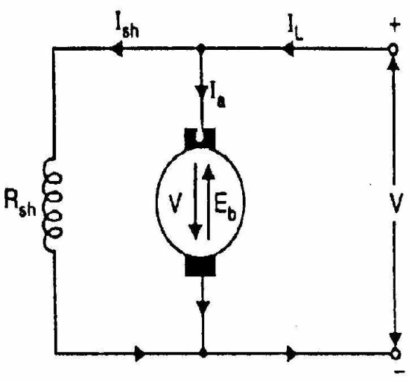
Back or Counter E.M.F.
E_{b}=φZNP/60 A
The induced e.m.f. acts in opposite
direction to the applied voltage V
(Lenz’s law).
Net voltage across armature circuit = V - Eb
I_{a}= (V – Eb)/R_{a}

Slide 39
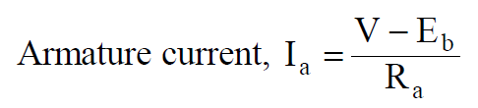
Significance of Back EMF
The back emf opposes the supply voltage. The supply voltage induces the current in the coil which rotates the armature. The electrical work required by the motor for causing the current against the back emf is converted into the mechanical energy. And that energy is induced in the armature of the motor. Thus, we can say that energy conversion in DC motor is possible only because of the back emf.
The back emf makes the DC motor self-regulating machine, i.e., the back emf develops the armature current according to the need of the motor.
V = E_{b}+I_{a}R_{a} ............... Voltage Equation
VI_{a} = E_{b}I_{a} + I_{a}²R_{a} ........Power Equation

Slide 40
Torque equation of a DC motor
When armature conductors of DC motor carry current in the presence of stator field flux, a mechanical torque is developed between the armature and the stator. Torque is given by the product of the force and the radius at which this force acts.
Torque T = F × r (N-m) …where, F = force and r = radius of the armature
Work done by this force in once revolution = Force × distance = F × 2πr (where, 2πr = circumference of the armature)

Slide 41
Net power developed in the armature = word done / time
= (force × circumference × no. of revolutions) / time
= (F × 2πr × N) / 60 (Joules per second)
But, F × r = T and 2πN/60 = angular velocity ω in radians per second. Putting these in the above equation
Net power developed in the armature = P = T × ω (Joules per second)

Slide 42
Armature torque (Ta)
The power developed in the armature can be given as, Pa = Ta × ω = Ta × 2πN/60
The mechanical power developed in the armature is converted from the electrical power,
Therefore, mechanical power = electrical power
That means, Ta × 2πN/60 = Eb.Ia
We know, Eb = PΦNZ / 60A
Therefore, Ta × 2πN/60 = (PΦNZ / 60A) × Ia
Rearranging the above equation,
Ta = (PZ / 2πA) × Φ.Ia = 0.159ΦZIa. P /A (N-m)

Slide 43
Shaft Torque (Tsh)
Due to iron and friction losses in dc machines, the total developed armature torque is not available at the shaft of the machine. Some torque is lost, and therefore, shaft torque is always less than the armature torque.
Shaft torque of a DC motor is given as,
Tsh = output in watts / (2πN/60) ....(where, N is speed in RPM)

Slide 44
Types of DC MOTORS
D.C. Motors
Series Wound
Shunt Wound
Compound Wound
Long Shunt
Short Shunt
C.C D.C
C.C D.C

Slide 45
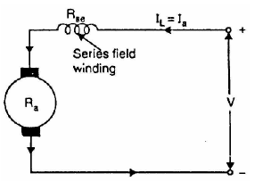
Series Motor
Armature current, Ia = Ise = IL = I
Terminal voltage, V = E_{b} + I(Ra + Rse) + V_{brush}
Applications: Series Motors are used in Electric traction, Trolley cars, cranes and hoists, elevators, air compressors, vacuum cleaners, hair drier, sewing machines etc.

Slide 46
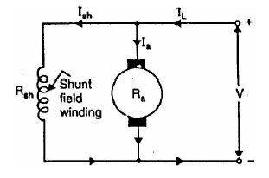
Shunt Motor
Applications: Shunt Motors are used for Lathes, Machine tools, Blowers and fans, Reciprocating pumps.
Shunt field current, Ish = V/Rsh
Armature current, Ia = IL – Ish
Terminal voltage, V = E_{b} + IaRa + V_{brush}

Slide 47
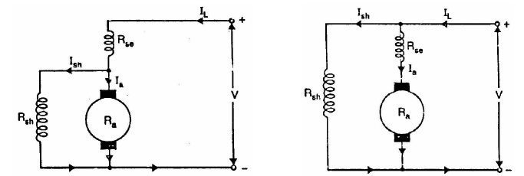

Compound Motor
Short Shunt
Long Shunt
Series field current, Ise = IL
Shunt field current, Ish
Terminal voltage,V= E_{b} + IaRa + IseRse + Vbrush
Series field current, Ise = Ia = IL - Ish
Shunt field current, Ish = V/Rsh
Terminal voltage, V = E_{b} + Ia(Ra + Rse) + Vbrush

Slide 48
Applications
Cumulatively Compound generators are used for Motor driving, for lamp loads and for heavy power services such as electric railways.
Differentially Compound Generators are used in Arc welding.

Slide 49
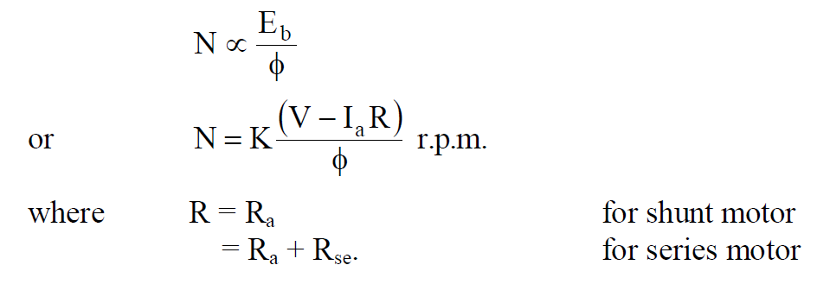
Speed Control of D.C. Motors
The speed of DC motor is
(i) Flux control method
(ii) Armature voltage control method

Slide 50
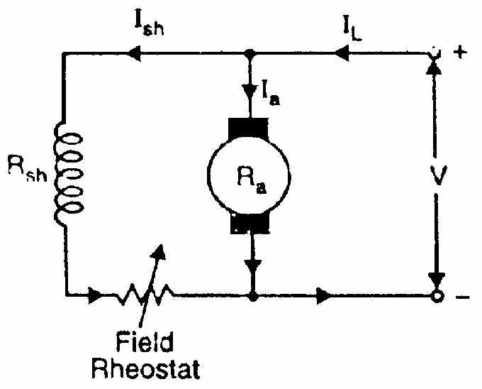
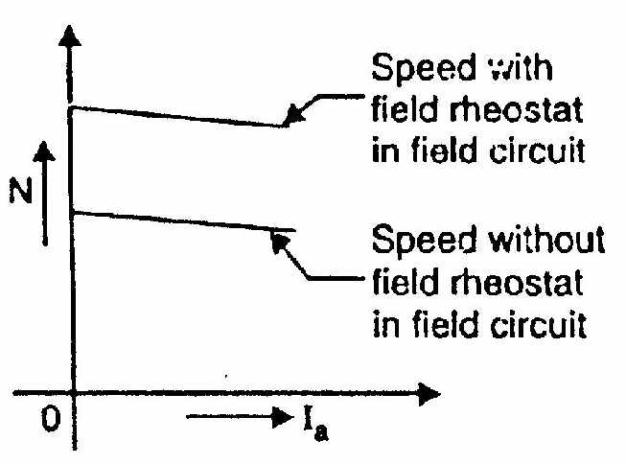
Speed Control methods of D.C. Shunt Motors
(i) Flux control method:
N ∝ 1/Φ;
(Speeds above the normal speed)
It is based on the fact that by varying the flux Φ , the motor speed can be changed and hence the name flux/field control method.
In this method a variable resistance is placed in series with field winding as shown in figure.
The field rheostat reduces the field current I_{f}. Hence the flux is reduced, therefore we can only raise the speed of the motor above the normal speed.

Slide 51
Advantages:
(i) This is an easy and convenient method.
(ii) It is an inexpensive method since very little power is wasted in the shunt field rheostat due to relatively small value of I_{sh}.
(iii) The speed control exercised by this method is independent of load on the machine.
Disadvantages:
(i) Only speeds higher than the normal speed can be obtained since the total field circuit resistance cannot be reduced below R_{sh}.
(ii) There is a limit to the maximum speed obtainable by this method. It is because if the flux is too much weakened, commutation becomes poorer.
Note: The field of a shunt motor in operation should never be opened because
its speed will increase to an extremely high value.

Slide 52
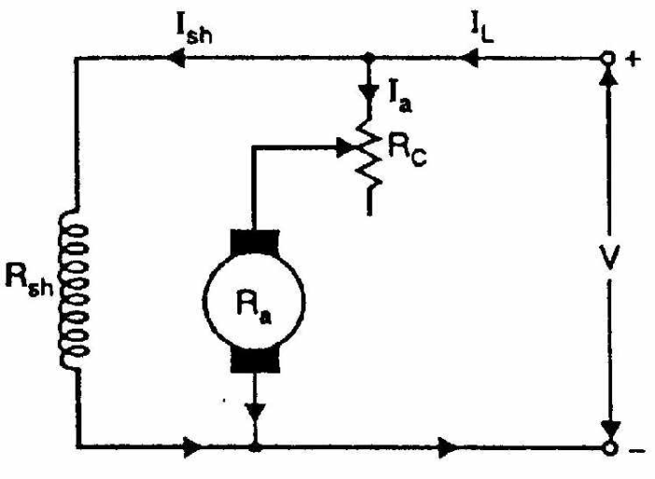
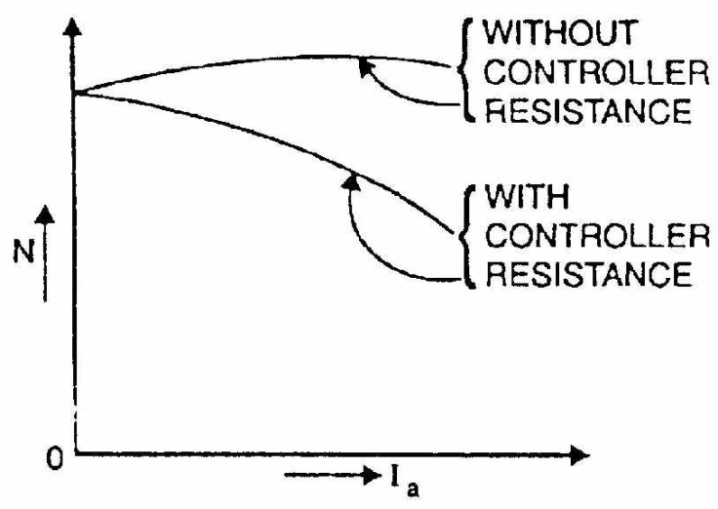
(ii)Armature voltage Control method
(speeds below the normal speed)
N ∝ E_{b} ∝ V - I_{a} (R_{a} + R_{C} )
This method is based on the fact that by varying the voltage available across the armature . The voltage across the armature is varied by inserting a variable resistance (Rheostat) in series with the armature circuit as shown in figure.
When R increases voltage drop increases then E_{b} decreases. The highest speed obtainable is normal speed. Hence this methods is used when speed below the normal speeds are required.

Slide 53
Types of Losses in DC machine
Electrical or Copper losses (I²R Losses)
Core Losses or Iron Looses
Mechanical losses
Stray Load Losses

Slide 54
Electrical or Copper losses
Resistive losses in the armature and field windings of the machine are called electrical or copper losses or Ohmic losses.
This loss varies with the variation of load on the machine and is called variable loss. When a motor is loaded, its armature current increases.
The various copper losses in the DC machine are as follows.
Armature copper loss = I²_{a}R_{a}
Shunt field copper loss = VI_{sh}
Series field copper loss = I²_{se}R_{se}

Slide 55
Core Losses or Iron Looses
Core losses are also known as iron losses or Magnetic losses. Core losses can be classified into two types:-
Hysteresis Losses
Eddy current Losses

Slide 56
Hysteresis Losses
The armature core is made up of magnetic material and is subjected to variations in magnetic flux. When the armature rotates it comes under North and South poles alternately.
Hysteresis loss occurs due to the alternate magnetization of the atoms, forming domains in the magnetic material of the core
Hysteresis Loss = K_{h}.V.f.B_{m}^{1.6}

Slide 57
Eddy current loss
Eddy current loss is due to the presence of circulating current in the core material. The armature core cuts the magnetic flux during its rotation and EMF is induced in the body of the core according to the laws of electromagnetic induction. This emf is very small but it sets up a large current in the body of the core.
Eddy current losses = K_{e} × B_{m}² × f² × t²

Slide 58
Mechanical Losses
The mechanical losses in a dc machine are the losses associated with mechanical effects. Mechanical losses occur at the bearing and shaft and air friction (windage loss) due to rotation of the armature.
There are two basic types of mechanical losses:
Frictional losses
Windage losses

Slide 59
Stray Load Looses
The magnetic and mechanical losses are known as stray losses. Stray losses are also known as rotational losses.
Total Losses = Constant losses + Variable losses

Slide 60
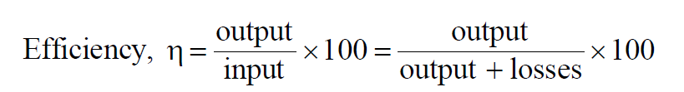
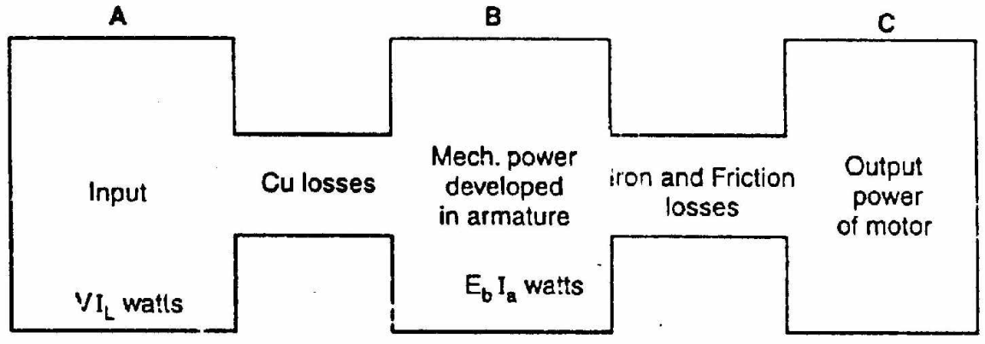
Efficiency of a D.C. Motor
The efficiency of a DC motor will be maximum when: Variable losses=Constant losses
Power stages in a D.C. Motor
A-B=Copper losses
B-C=Iron and friction losses
Overall efficiency, η_{c} = C/A
Electrical efficiency, η_{e} = B/A
Mechanical efficiency,η_{m} = C/B

Slide 61
Swinburne’s Test
It is an indirect method of testing of DC machines. In this method the losses are measured separately and the efficiency at any desired load is predetermined. Machines are tested for finding out losses, efficiency and temperature rise. For small machines direct loading test is performed. For large shunt machines, indirect methods are used like Swinburne’s test.

Slide 62
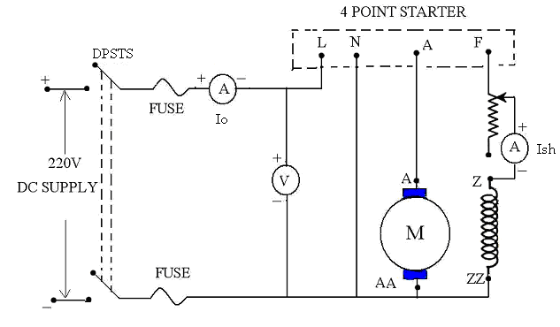
Procedure
It is a simple indirect test which is applicable where flux' is constant like shunt machine.
The machine is run as motor at no load at its rated speed with the help of shunt field
resistance.
The supply voltage, no load input current and field current are measured by ammeters.
Then the no load armature current I_{a0} = I_{o}-I_{sh} amps.
Circuit Diagram

Slide 63
Where I_{o} = No load input current
I_{sh} = Shunt field current
No load input power = V * I_{o} watts
Constant losses (W_{C}) = input - Ar. cu. losses = V I_{o} – (I_{ao})²R_{a}
Where R_{a} = armature resistance
Efficiency of Machine as a motor:
Let motor input Current = I amps
Terminal voltage = V volts
Input Power = VI watts
Output power =Input – Losses
=V I - (W_{C} + (I_{a})²R_{a}) watts
Where I_{a} = I - I_{sh} Amps
% Efficiency = (output/input)* 100

Slide 64
Efficiency of machine as a generator:
Let output current supplied by the generator = I Amps
Terminal voltage = V volts
Output of the generator = V I watts
Input = Output + Losses = V I + (W_{c} + [I_{a}]²R_{a}) watts,
where I_{a} = I + I_{sh}
% Efficiency of generator = (output/input) *100
Advantages:
1.Efficiency and losses at any desired load can be determined due to knowing of losses.
2.Though the test is carried on dc machine as a motor, the efficiency & losses can be evaluated for motor as well as generator.
3.This test is very simple and is suitable for only shunt and compound motors.
Disadvantages:
1.It is a no-load test so it cannot be applicable for series motor.
2.Temperature rise in machine on load condition cannot be predicted.

Slide 65
Thank You

