Slide 1
BASIC ELECTRICAL ENGINEERING
UNIT- III
1- PHASE TRANSFORMERS
3- PHASE INDUCTION MOTORS
3- PHASE ALTERNATORS
By
M. Bhagya Lakshmi
Assistant Professor,
Department of EEE.
G. Pullaiah College of Engineering and Technology
Kurnool – 518452, Andhra Pradesh, India

Slide 2
Single phase Transformers
Principle of Operation of Single Phase transformer
Types of Transformers
Constructional Features
EMF Equation of Transformer
Losses, Efficiency and Regulation of Transformer
OC and SC Tests

Slide 3
Transformer
A static device which helps in the transformation of electric power in one circuit to electric power of the same frequency in another circuit.
The voltage can be raised or lowered in a circuit, but with a proportional increase or decrease in the current ratings.

Slide 4
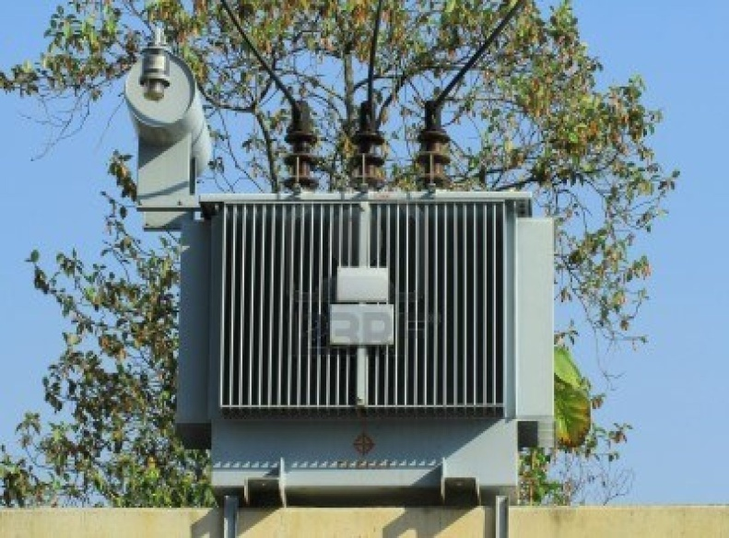
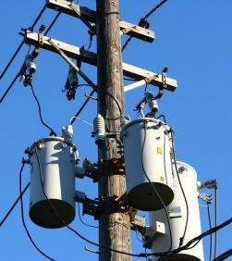
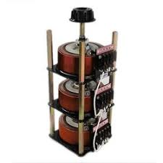
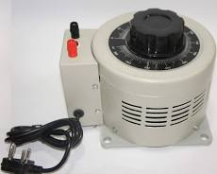
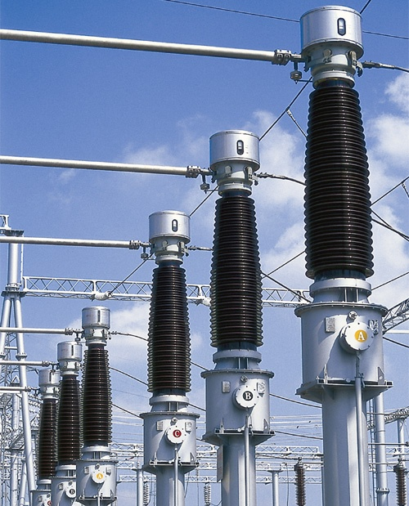
Applications of Transformers
There are four principal applications of transformers viz.
( i ) Power transformers ( ii ) Distribution transformers
( iii ) Autotransformers ( iv ) Instrument transformers

Slide 5
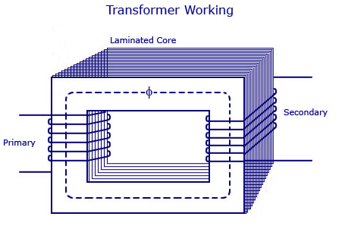
Working Principle
The main principle of operation of a transformer is mutual inductance between two circuits which is linked by a common magnetic flux.
A basic transformer consists of two coils that are electrically separated and inductive, but are magnetically linked through a path of reluctance.

Slide 6
Operation of Transformer
The transformer has primary and secondary windings.
The core laminations are joined in the form of strips.
A mutual electro-motive force is induced in the transformer from the alternating flux that is set up in the laminated core, due to the coil that is connected to a source of alternating voltage.
Most of the alternating flux developed by this coil is linked with the other coil and thus produces the mutual induced electro-motive force.
The so produced electro-motive force can be explained with the help of Faraday’s laws of Electromagnetic Induction as : e=M*dI/dt

Slide 7
If the second coil circuit is closed, a current flows in it and thus electrical energy is transferred magnetically from the first to the second coil.
The alternating current supply is given to the first coil and hence it can be called as the primary winding.
The energy is drawn out from the second coil and thus can be called as the secondary winding.

Slide 8
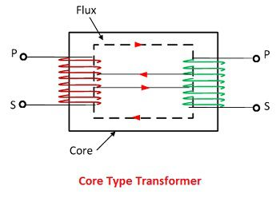
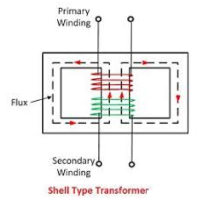
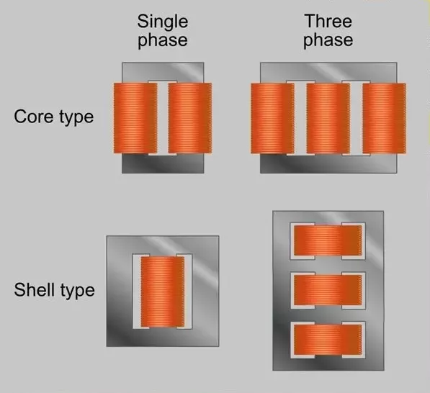
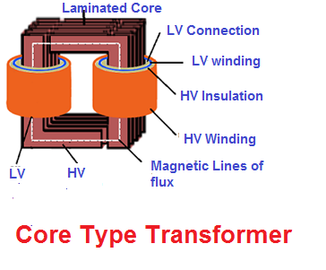
Types of Transformers

Slide 9
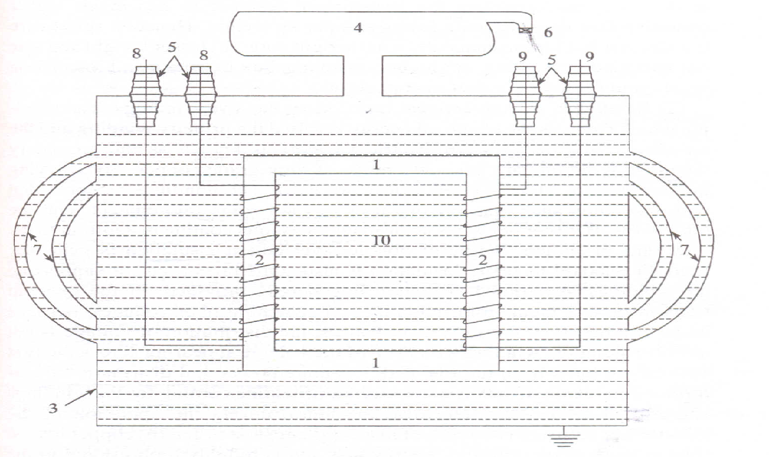
Construction of Transformer

Slide 10
Constructional Details of Transformers
The Important parts of a transformer are:
Core
Windings
Tank
Conservator
Bushings
Breather
Radiators
Winding leads (input)
Winding leads (Output)
Transformer Oil

Slide 11
Core
Transformer core is made up of silicon steel or sheet steel with 4% silicon
Sheets are laminated with an oxide layer to reduce the iron losses.
The thickness of laminations are 0.35mm for 60Hz and 5 mm for 25 Hz operations.
The purpose of the core is to provide a magnetic path of low reluctance between the two windings so that whenever one winding is excited, the flux established by the winding will link fully with the other winding without any appreciable leakage.

Slide 12
Windings
Transformer has two windings.
Primary winding which receives energy.
Secondary winding which delivers energy.
The windings are provided with insulation such that any one turn will not come into contact with other turn.
For carrying higher currents standard conductors are used.

Slide 13
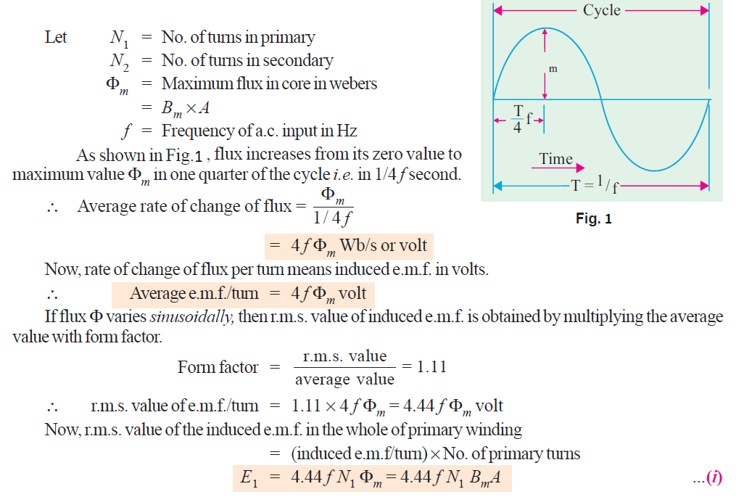
EMF Equation of a Transformer

Slide 15
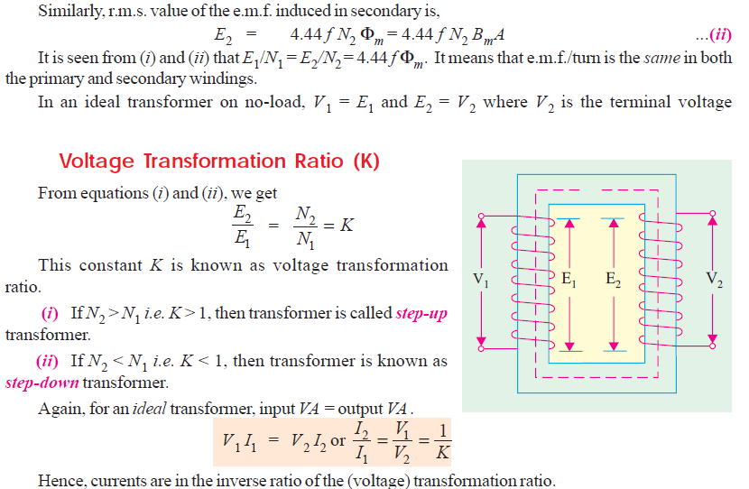

Slide 16
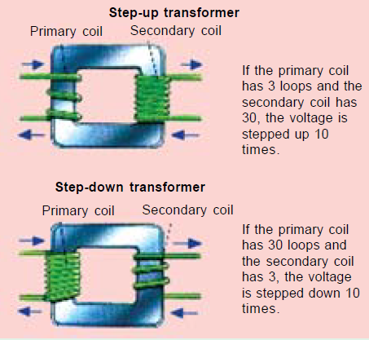

Slide 17



Losses in a Transformer
Losses appear in the form of heat and produce (i) an increase in
temperature and (ii) a drop in efficiency.
1. Core or Iron losses (Pi)
2. Copper losses

Slide 18
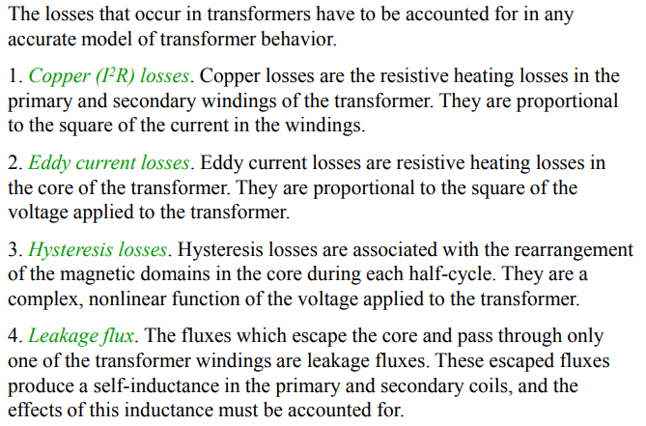
Losses in a Transformer

Slide 19


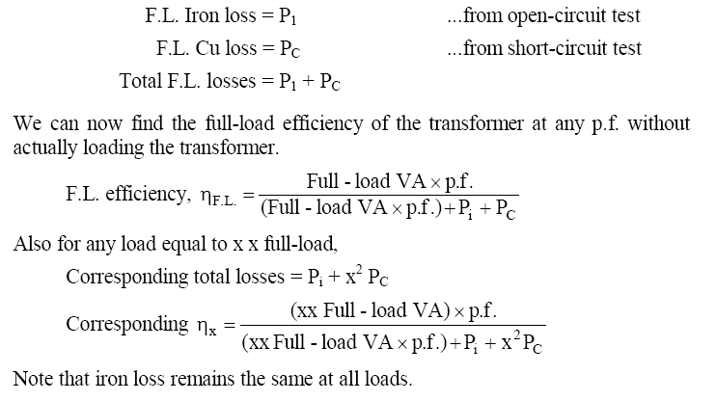
Efficiency of a Transformer
Efficiency from Transformer Tests:

Slide 23
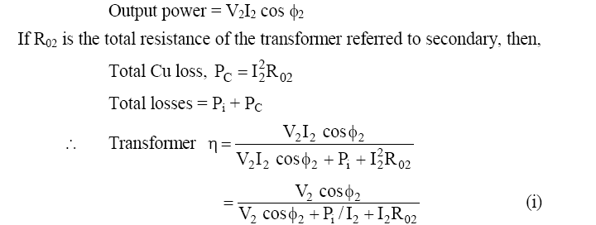
Condition for Maximum Efficiency:

Slide 24
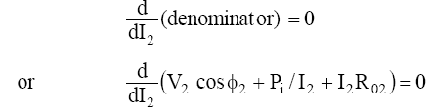
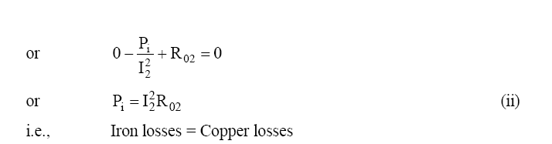
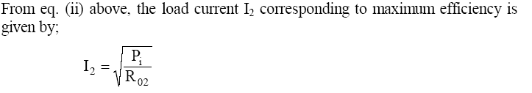

Slide 25
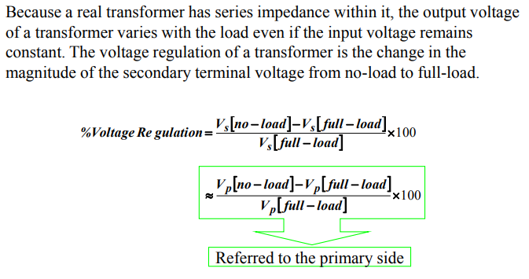
Transformer Voltage Regulation

Slide 26
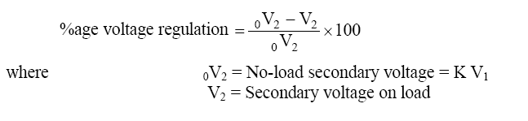
Voltage Regulation
The +ve sign is for lagging p.f. and -ve sign for leading p.f.
It may be noted that %age voltage regulation of the
transformer will be the same whether primary or secondary
side is considered.

Slide 27
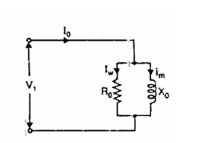
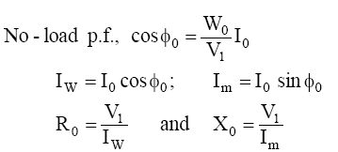
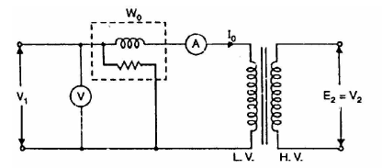
Transformer Tests
Open-Circuit or No-Load Test:
To determine the iron losses (core
losses) and parameters R₀ and X₀ of the
transformer
Rated voltage is applied to the primary
(usually low-voltage winding) while the
secondary is left open circuited.

Slide 29
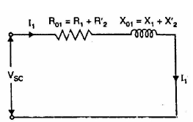
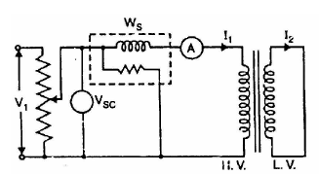
Transformer Tests
Short-Circuit or Impedance Test:
To determine R₀₁(or R₀₂), X₀₁ (or X₀₂)
and full-load copper losses of the
transformer.
The secondary (usually low-voltage
winding) is short-circuited by a thick
conductor and variable low voltage (Vsc)
is applied such that full-load current I₁
flows in the primary.

Slide 30
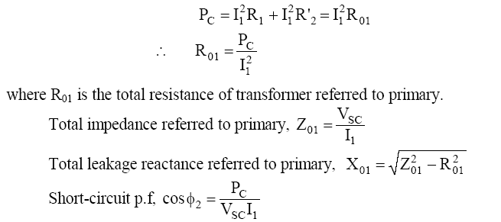

Slide 31
3- Φ Induction Motors
Introduction
Principle of operation
Types of Induction Motors
Slip, Torque
Torque-Slip characteristics

Slide 32
Introduction
An electric motor is a device which converts an electrical energy into a mechanical energy. This mechanical energy then can be supplied to various types of loads. The motors can operate on DC as well as 1-Φ and 3-Φ AC supply.
The motors operating on DC supply are called DC motors, while motors operating on AC supply are called AC motors.
The AC motors are classified as 1-Φ and 3-Φ Induction motors, Synchronous motors and some special purpose motors. Out of all these types, 3-Φ Induction motors are widely used for various industrial applications.

Slide 33
Why Induction Motors
Advantages
(i) It has simple and rugged construction.
(ii) It is relatively cheap.
(iii) It requires little maintenance.
(iv) It has high efficiency and reasonably good power
factor.
It has self starting torque.
Disadvantages
(i) It is essentially a constant speed motor and its speed
cannot be changed easily.
(ii) Its starting torque is inferior to D.C. shunt motor.

Slide 34
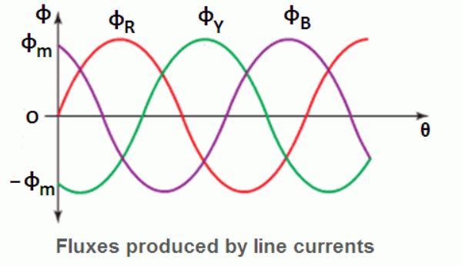
Rotating Magnetic Field (RMF)
The working of 3- ф Induction motors is based on the production of Rotating Magnetic Field (RMF).
The Rotating magnetic field can be defined as the field or flux having constant amplitude but whose axis is continuously rotating in a plane with a certain speed (Synchronous speed Ns).
In 3-Φ Induction motors, such a rotating magnetic field is produced by supplying currents to a set of stationary windings, with the help of 3-Φ AC supply.
The current carrying windings produce the magnetic field or flux and due to interaction of three fluxes produced due to 3- ф supply, resultant flux has a constant magnitude and its axis rotating in space, without physically rotating three windings.
This type of field is nothing but Rotating Magnetic Field (RMF).

Slide 35
Speed of RMF
There exists a fixed relation between frequency f of AC supply to the windings, the number of poles P for which winding is wounded and speed N rpm of the rotating magnetic field.
For a standard frequency whatever speed of RMF results is called Synchronous Speed, in case of induction motors, it is denoted as Ns
Ns = (120f/P) = Speed of RMF
f- supply frequency
P= number of poles for which stator winding is wounded
This is the speed with which RMF rotates in space.
Applications of Induction Motors:
Fans, Blowers, Machine tools
Compressor, Crushers, Conveyors,
Cranes, Compressors, Elevators, Hoist etc

Slide 36
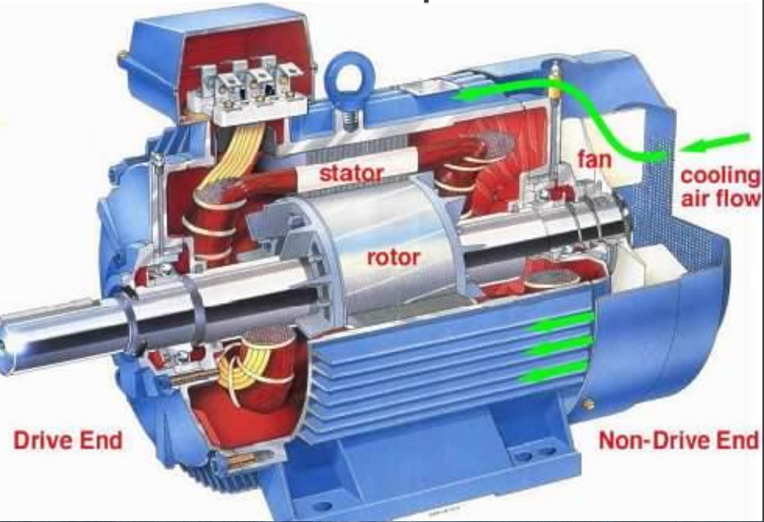

Slide 37
Rotor:
Stator:
Stator of an IM consists of steel frame which contains hallow cylindrical hole made up of thin laminations of silicon steel to reduce hysteresis and eddy current losses.
The number of evenly spaced slots are provided on inner periphery of the laminations. The insulated conductors are placed in the stator slots and are suitably connected to form a balanced 3-Φ star or delta connections.
Rotor is mounted on the shaft is a hallow laminated core having slots on its outer periphery, the windings are placed in these slots are called rotor windings and they may be of many types like:
Squirrel Cage Rotor Type IM
Slip Ring Rotor Type IM

Slide 38
Principle of Operation of 3- ф Induction Motor
Induction motor works on the principle of Electromagnetic Induction.
When a 3-Φ supply is given to the 3-Φ stator winding, a rotating magnetic field of constant magnitude (1.5φ_{m}) is produced. The speed of this rotating magnetic field is synchronous speed, Ns = 120f/P rpm
This rotating field produces an effect of rotating poles around a rotor, Let direction of rotation of this rotating magnetic field is clockwise as shown in Fig. 1. (a).
Now at this instant rotor is stationary and stator flux RMF is rotating. So its obvious that there exists a relative motion between the RMF and rotor conductors.
Now RMF gets cut by the rotor conductors as RMF sweeps over rotor conductors. Whenever conductor cuts the flux, EMF gets induced in it called Rotor Induced EMF (Faradays laws).
As rotor forms closed circuit, induced emf circulates current through rotor called rotor current.

Slide 39
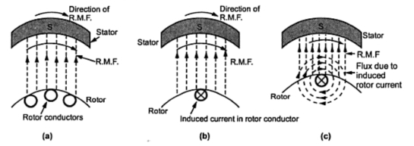
Fig. 1 Principle of Operation of 3- ф Induction Motor

Slide 40
Let direction of this current is going into the paper denoted by (X) in Fig.1. (b).
Any current carrying conductor produces its own flux, so rotor produces its flux called Rotor flux. For assumed direction of rotor current, the direction of rotor flux is clockwise.
Now there exists two fluxes, one RMF and other is rotor flux. Both the fluxes interact with each as shown in Fig. 1(c).
On left of rotor conductors, two fluxes are in same direction hence add up to get high flux area. On the right side, two fluxes cancel each other to produce low flux area. As flux lines act like a stretched rubber band, high flux density area exerts a push on rotor conductor towards low flux density area. So rotor conductors experiences a force from left to right.
As all the rotor conductors experiences a force, the overall rotor experiences a torque and starts rotating, So interaction of the two fluxes is very essential for a motoring action.
Hence rotor starts rotating in the same direction as that of rotating magnetic field.

Slide 41
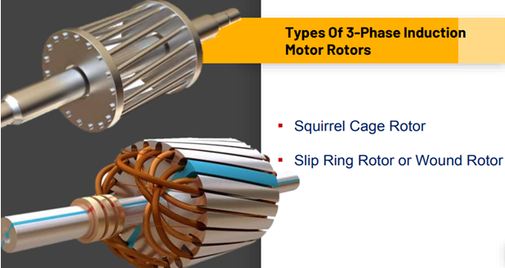
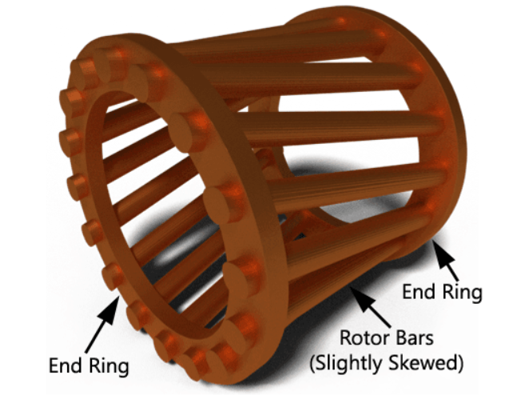
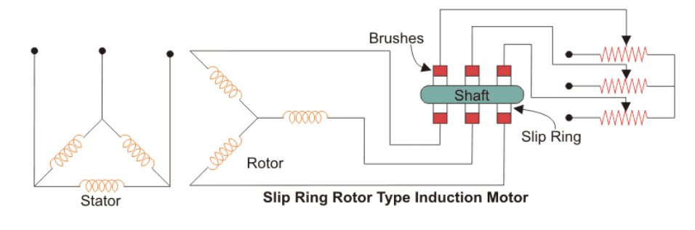
Types of 3- ф Induction Motor
Squirrel Cage IM
Slip Ring IM
Skewing : Making rotor conductor not parallel to the axis of the shaft.

Slide 42
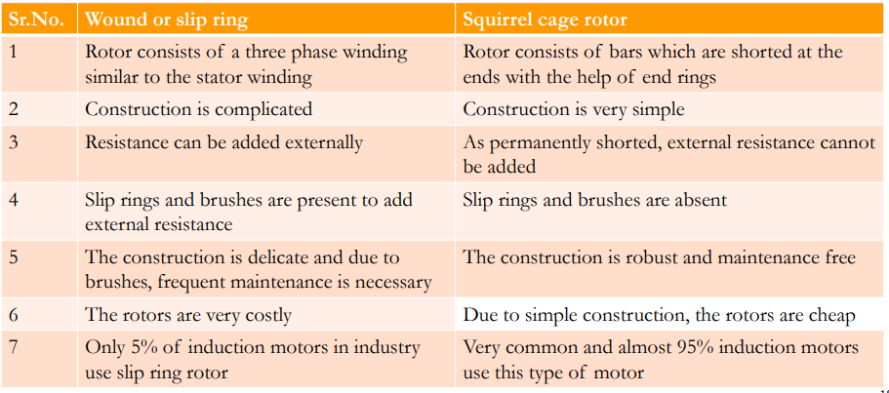
Comparison of Wound rotor and
Squirrel Cage rotor

Slide 43
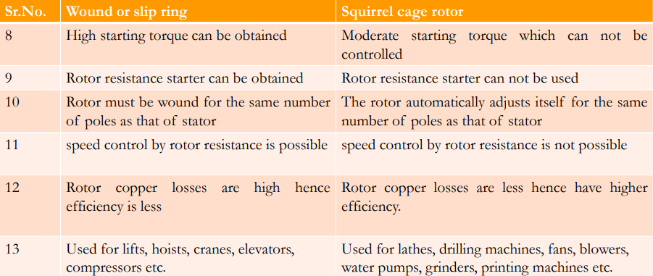

Slide 44
Slip of 3- ф Induction Motor
Slip is defined as the ratio of difference between synchronous speed and rotor speed to the synchronous speed
Let N_{s}= Speed of rotating magnetic field in rpm
N = speed of rotor i.e. motor in rpm
N_{s}-N = Relative speed between the two speeds is called Slip speed
In practical, rotor continues to rotate with a speed slightly less than the synchronous speed of the rotating magnetic field (N<N_{s}) .
Induction motor never rotates at synchronous speed.
s= (N_{s}-N)/N_{s} ------------------------------ absolute slip
%s = (N_{s}-N)/(N_{s})*100------------------- percentage slip
At starting, actual speed N is zero , so S=1

Slide 45
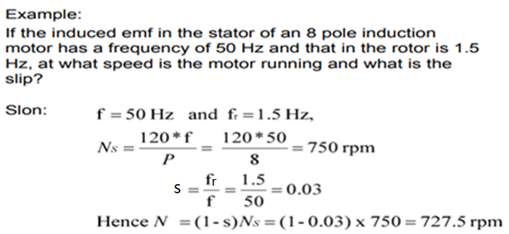
Formulae :
s = (N_{s}-N)/N_{s}
N = (1-s)N_{s}
f_{r} = P*N_{slip}/120 = P*(N_{s}-N)/120 =f*(N_{s}-N)/N_{s}
f_{r} =f*s

Slide 46
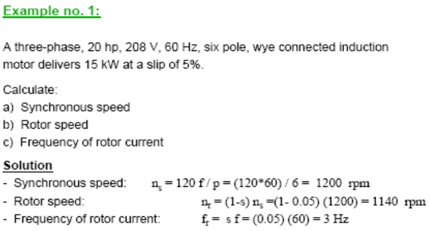

Slide 47
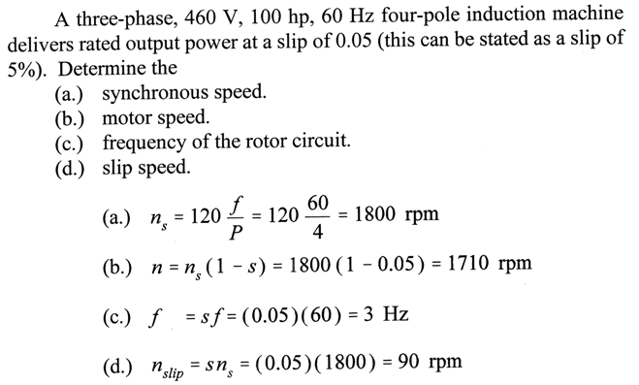

Slide 48
Torque Equation of 3- Φ Induction Motor
The torque produced in an induction motor depends on the following factors:
  The part of Rotating Magnetic Field (φ) which reacts with rotor and is responsible to produce induced emf in the rotor.
  The magnitude of rotor current in running condition (I₂)
  The power factor of the rotor circuit in running condition (cos Φ ₂)
  T α φ I_{2r} cos Φ_{2r}
  The flux produced by stator is proportional to stator voltage E₁ and rotor voltage E₂
  φ α E₂
  The Torque Equation of 3-Phase Induction Motor is given by
T = (180/2ΠN_{s})Ε₂²sR₂/[R₂²+(sX₂)²] = KsR₂/[R₂²+(sX₂)²]

Slide 49
Torque Slip Characteristics of Three phase IM
As the IM is loaded from no load to full load, its speed decreases hence slip increases.
The curve obtained by plotting torque against slip from s=1 (starting) to s=0 (at synchronous speed) is called Torque – Slip characteristics.
At constant supply voltage, E₂ is also constant, so we write torque equation as
T α sR₂/[R₂²+(sX₂)²]
Now to judge the nature of torque-slip characteristics, let us divide the slip range ( s = 0 to s = 1) into two parts and analyze them independently.
(i) Low Slip Region ( s = 0 to s = s_{m})
(ii) High Slip Region ( s = s_{m} to s = 1)

Slide 50
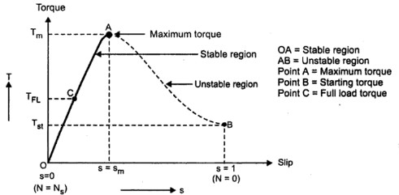
Fig. 1 Torque Slip Characteristics of Three phase Induction Motor

Slide 51
(i) Low Slip Region :
In low slip region, s is very very small. Due to this, the term (sX₂)² is so small as compared to R₂², that it can be neglected
T α s.R₂/ R₂² α s --- as R₂ is constant
Hence, in low slip region torque is directly proportional to slip. So as load increases, speed decreases, increasing the slip. This increases the torque which satisfies the load demand. Hence the graph is straight line in nature.
At N=N_{s}, s = 0 hence T= 0. As no torque is generated at N=N_{s}, motor stops if it tries to achieve the synchronous speed. Torque increases linearly in this region, of low slip values.
So range s = 0 to s = s_{m} is called low slip region, known as Stable region of operation.

Slide 52
(ii) High Slip Region :
In this region, slip is very high i.e. slip value is approaching 1. Here it can be assumed that the term R₂² is very very small as compared to (sX₂)² Hence neglecting R₂² from the denominator, we get.
T α s.R₂/ (sX₂)² α 1/ s --- as X₂ & R₂ are constants
So in high slip region torque is inversely proportional to the slip. Hence it is like rectangular hyperbola.
Now when load increases, load demand increases but speed decreases. As speed decrease, Slip increases, In high slip region as T α 1/ s , torque decreases as slip increases.
But torque must increase to satisfy the load demand. Again torque decreases as T α 1/ s hence same load acts as an extra load due to reduction in torque produced.
Hence speed further drops. Eventually motor comes to standstill condition. The motor cannot continue to rotate at any point in this high slip region. Hence this region is called Unstable region of operation.
So range s = s_{m} to s = 1 is called High slip region, known as Unstable region of operation.

Slide 53
3- Φ Alternators
(or) Synchronous Generators
Introduction
Principle of operation
Constructional details
EMF Equation

Slide 54
Introduction
A.C. system has number of advantages over D.C. system.
These days 3-phase AC system is being exclusively used for generation, transmission and distribution of power.
The machine which produces 3-phase power from
mechanical energy is called an alternator or synchronous generator.
Alternators are the primary source of all the electrical energy we consume. These machines are the largest energy converters found in the world.

Slide 55
Principle of operation
An alternator operates on the same fundamental principle of electromagnetic induction as a D.C. generator i.e., when the flux linking a conductor changes, an e.m.f. is induced in the conductor.
Like a D.C. generator, an alternator also has an armature winding and a field winding, but there is one important difference between the two.
In a DC generator, the armature winding is placed on the rotor in order to provide a way of converting alternating voltage generated in the winding to a direct voltage at the terminals through the use of a rotating commutator.
The field poles are placed on the stationary part of the machine.

Slide 56
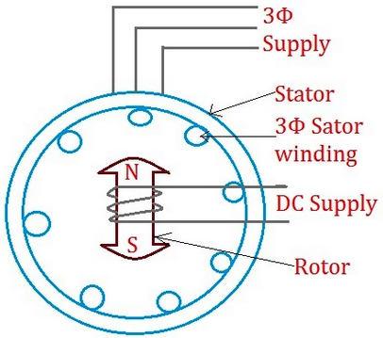
Since no commutator is required in an alternator, it is usually more convenient and advantageous to place the field winding on the rotating part (i.e., rotor) and armature winding on the stationary part (i.e., stator) as shown in Fig. 1.
Fig. 1 Synchronous Generators

Slide 57
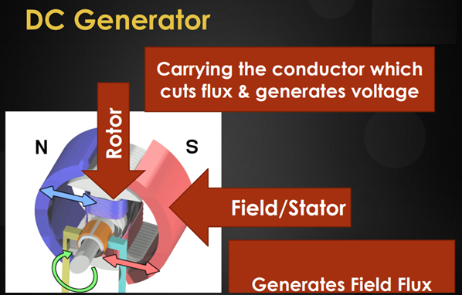
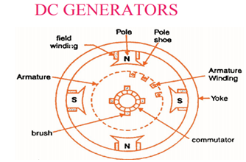
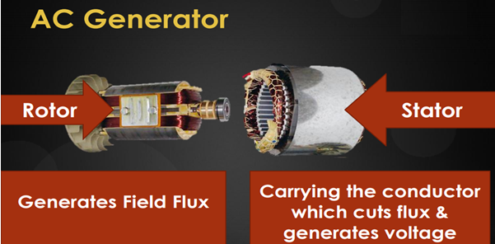
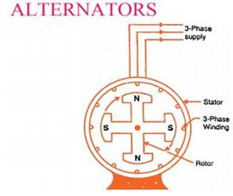

Slide 58
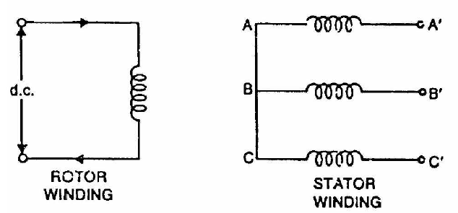
Operation of Alternator:
Fig. 1.
Fig. 1. shows a star-connected armature winding and D.C. field
winding.
The rotor winding is energized from the DC exciter and alternate N and S poles are developed on the rotor.
When the rotor is rotated in anti-clockwise direction by a prime mover, the stator or armature conductors are cut by the magnetic flux of rotor poles.
Consequently, e.m.f. is induced in the armature conductors due to
electromagnetic induction. The induced e.m.f. is alternating since N and S poles of rotor alternately pass the armature conductors.

Slide 59
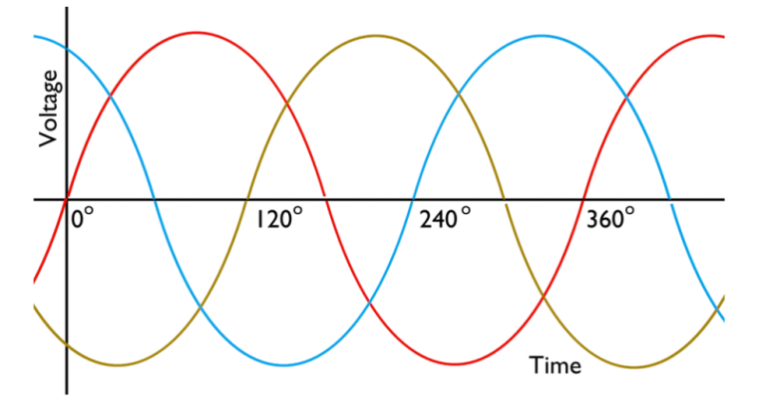
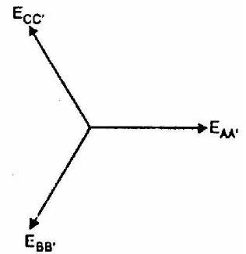
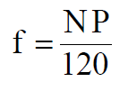
(i) (ii)
Fig. 2 Three phase voltage
The magnitude of the induced e.m.f. is same in each phase as shown in Fig. 2 (i)
and depends upon DC exciting current, rotor flux, the number and position of the
conductors in the phase and the speed of the rotor.
However, they differ in phase by 120° electrical as shown in phasor diagram in
Fig. 2 (ii).
The direction of induced e.m.f. can be found by Fleming’s right hand rule and its
frequency is given by;
where N = speed of rotor in r.p.m.
P = number of rotor poles

Slide 60
CONSTRUCTION OF ALTERNATOR/ SYNCHRONOUS GENERATOR
Basic parts of a Synchronous generator are
Stator – Stationary part of the machine.
It carries armature winding in which voltage is generated.
It has a three phase winding excited by AC supply.
The output of the machine is taken from the stator.
Rotor – It is the rotating part of the machine.
It carries the field winding which is excited by a DC source.
Thus rotor produces main field flux.

Slide 61
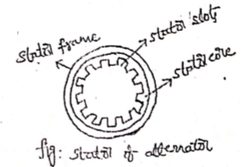
STATOR CONSTRUCTION
Various parts of stator include:
Stator frame
Stator windings
Stator core
Stator frame is made up of cast iron for
small sized machines.
For large machines, stator core is made up of
Silicon steel or sheet steel to reduce
hysteresis loss and eddy current loss.
Stator core is built with sheet steel
laminations having slots on its inner periphery.
A three phase winding is placed on these slots
which serves as armature winding.
Armature winding is always connected in Star.

Slide 63
ROTOR CONSTRUCTION
Rotor carries a field winding which is supplied with Direct Current through two slip rings by a separate DC source.
This DC source is called as EXCITER and is generally a DC shunt generator or a DC compound generator mounted on the shaft of the alternator.;
Rotor construction is of two types
Salient (or Projecting) pole type
Non- Salient (or Cylindrical) pole type

Slide 64

TYPES OF SYNCHRONOUS MACHINES

Slide 65


(i) Salient pole type Rotor :
In this type, salient or projecting poles are mounted on a large circular steel frame which is fixed to the shaft of the alternator as shown in Fig. 1.
The individual field pole windings are connected in series in such a way that when the field winding is energized by the DC exciter, adjacent poles have opposite polarities.
Fig. 1. Salient Pole Rotor

Slide 66

Low and medium-speed alternators (120-400 r.p.m.) such as those driven by diesel engines or water turbines have salient pole type rotors due to the following reasons:
(a) The salient field poles would cause an excessive windage
loss if driven at high speed and would tend to produce
noise.
(b) Salient-pole construction cannot be made strong enough
to withstand the mechanical stresses to which they may
be subjected at higher speeds.
Since a frequency of 50 Hz is required, we must use a large number of poles on the rotor of low-speed alternators.
Low-speed rotors always possess a large diameter to provide the necessary space for the poles.
Consequently, salient-pole type rotors have large diameters and short axial lengths.
More Details

Slide 67


(ii) Non-Salient pole type Rotor :
In this type, the rotor is made of smooth solid forged-steel radial cylinder having a number of slots along the outer periphery.
The field windings are embedded in these slots and are connected in series to the slip rings through which they are energized by the D.C. exciter.
The regions forming the poles are usually left unslotted as shown in Fig. 2. It is clear that the poles formed are non-salient i.e., they do not project out from the rotor surface.
Fig. 2. Non-Salient pole type Rotor

Slide 68

Comparison of Alternators
Salient Pole type
Non-Salient Pole type

Slide 69
Winding Factors
The armature winding of an alternator is distributed over the entire armature.
The distributed winding produces nearly a sine waveform and the heating is more uniform.
The coils of armature winding are not full-pitched i.e., the two sides of a coil are not at corresponding points under adjacent poles.
The distribution and pitching of the coils affect the voltages induced in the coils.
There are 2 types of winding factors :
  Distribution factor (K_{d}) or breadth factor
  Pitch factor (Kp) or chord factor

Slide 70



(i) Distribution factor (K_{d}) or breadth factor:
A winding with only one slot per pole per phase is called a concentrated winding.

Slide 71

(ii) Pitch factor (Kp) or chord factor (Kc):
A coil whose sides are separated by one pole pitch (i.e., coil span is 180 electrical) is called a full-pitch coil.
With a full-pitch coil, the e.m.f.s induced in the two coil sides are in phase with each other and the resultant e.m.f. is the arithmetic sum of individual e.m.fs.
However the waveform of the resultant e.m.f. can be improved by making the coil pitch less than a pole pitch. Such a coil is called short-pitch coil.
The e.m.f. induced in a short-pitch coil is less than that of a full pitch coil.
In general, if the coil span falls short of full-pitch by an angle α (electrical) then K_{p} =cos α/2

Slide 72

EMF Equation of Alternator

Slide 73

with
K_{p} =cos α/2 and

Slide 74

Formulae

Slide 75


Slide 76
Thank You

