Slide 1
G.PULLAIAH COLLEGE OF ENGINEERING AND TECHNOLOGY (AUTONOMOUS)
Data Structures Using C
Unit-III
QUEUES
By
P.Chandrakala
Assistant Professor
Department of Computer Science and Engineering

Slide 2
APPLICATIONS OF QUEUES

Slide 3
APPLICATIONS OF QUEUES
Simulation
CPU Scheduling in Multiprogramming Environment
Round Robin Algorithm

Slide 4
SIMULATION
Simulation is modelling of real life problem, or in other words, it is a model of real life situation in the form of a computer program.
The advantage of simulation is to experiment the danger areas such as military operations.
Any process or situation that is to be simulated is called as a system.
A system is a collection of interconnected objects which accepts zero or more inputs and produces atleast one output.

Slide 5
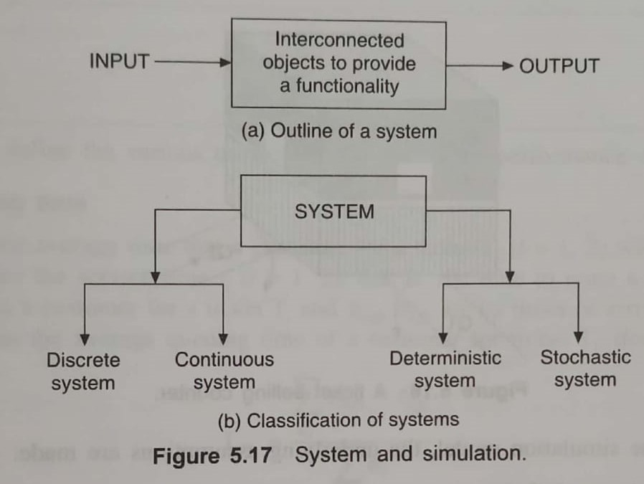

Slide 6
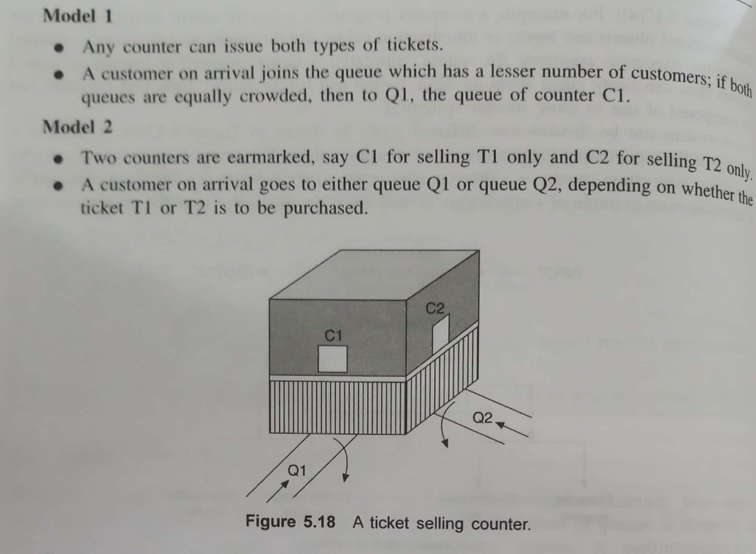
Example

Slide 7
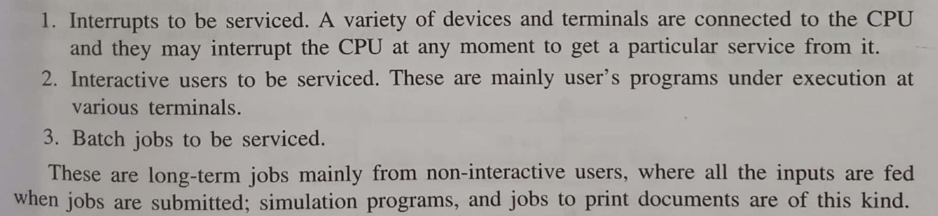
CPU SCHEDULING IN MULTIPROGRAMMING ENVIRONMENT
In a multiprogramming environment, a single CPU has to serve more than one program simultaneously.
The possible jobs for the CPU in a multiprogramming environment is categorized into three groups.

Slide 8
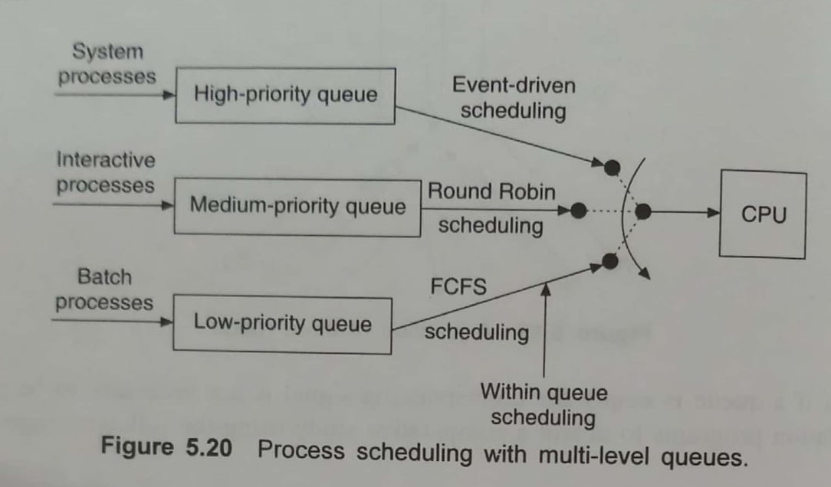

Slide 9
ROUND ROBIN ALGORITHM
A round Robin algorithm is a well known scheduling algorithm and is designed especially for time sharing systems.
Suppose, there are n processes P1,P2,….Pn required to be served by the CPU. Different processes require different execution times.
Arrival time is the point of time in milliseconds at which a process arrives at the ready queue to begin the execution.
Burst Time refers to the time required in milliseconds by a process for its execution.

Slide 10
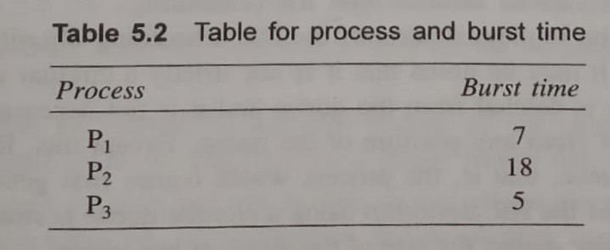
Example
The RR algorithm first decides a small unit of time, called a time quantum or time slice.
A time quantum is generally from 10 to 100 milliseconds.

Slide 11
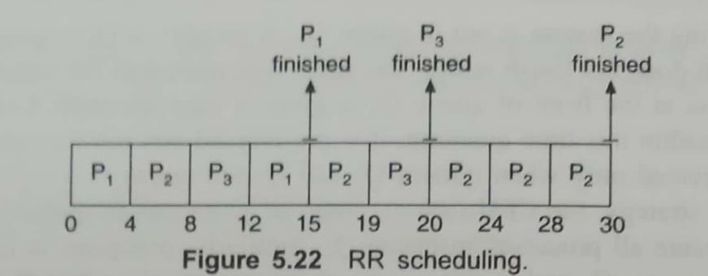
The total CPU time required is 30 unit.
Let us assume a time quantum of 4 unit.

Slide 12
