Slide 1
UNIT 5
Binary Tree Representations

Slide 2
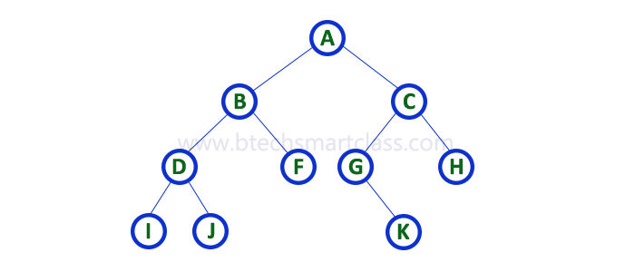
A binary tree data structure is represented using two methods.
Those methods are as follows...
Array Representation
Linked List Representation
Consider the following binary tree...

Slide 3

Array Representation of Binary Tree
In array representation of a binary tree,
we use one-dimensional array (1-D Array) to represent a binary tree.
Consider the above example of a binary tree and it is represented as follows...
To represent a binary tree of depth 'n' using array representation, we need one dimensional array with a maximum size of 2n + 1.

Slide 4

Linked List Representation of Binary Tree
We use a double linked list to represent a binary tree.
In a double linked list, every node consists of three fields.
-First field for storing left child address,
-second for storing actual data and
-third for storing right child address.
In this linked list representation, a node has the following structure...

Slide 5
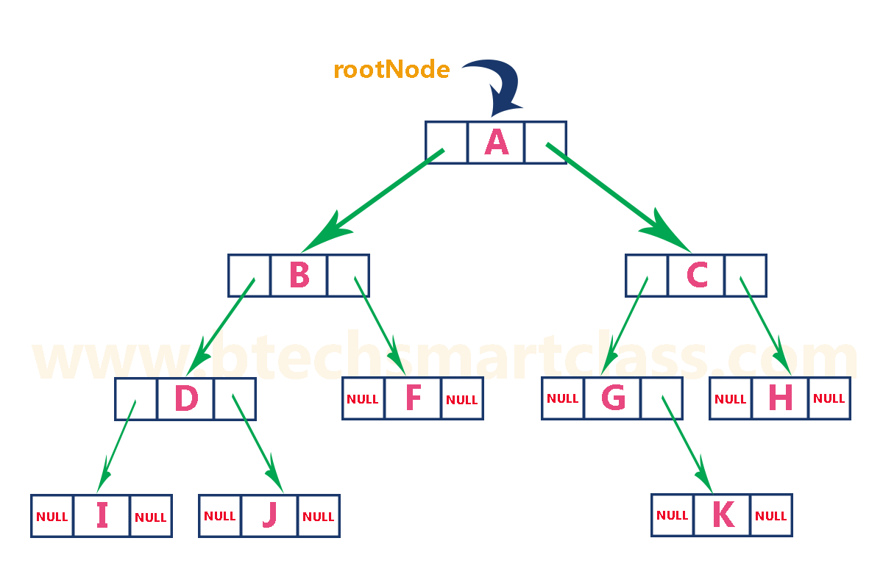
The above example of the binary tree represented using Linked list representation is shown as follows...

Slide 6
Binary Tree Operations

Slide 7
Binary Tree Operations
Insertion
Deletion
Traversing

Slide 8

Insertion
Example 1: Inserting elements one by one to create a binary tree
Select the first element of the list to be the root node.
(no. of elements on level-0: 1)
Select the first element as root

Slide 9
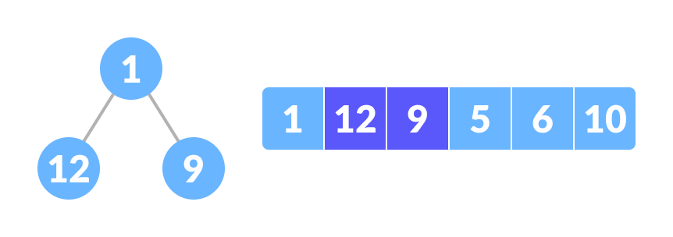
2. Put the second element as a left child of the root node and
the third element as the right child.
(no. of elements on level-I: 2)
3. Put the next two elements as children of the left node.
Again, put the next two elements as children of the right node.
(no. of elements on level-II: 4)
12 as a left child and 9 as a right child

Slide 10
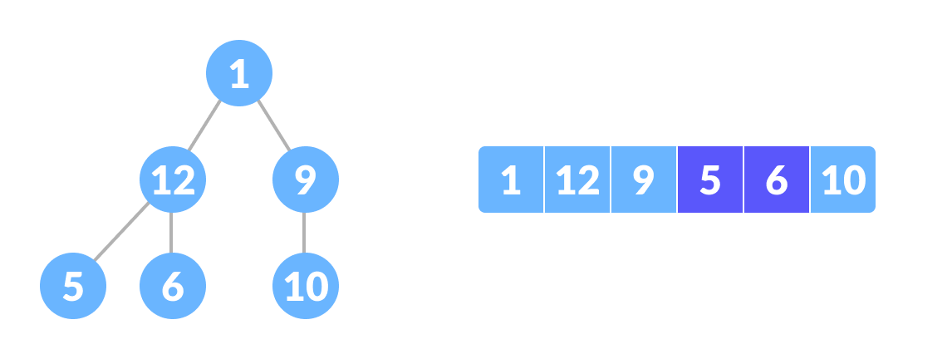
4. Keep repeating until you reach the last element.
5 as a left child and 6 as a right child

Slide 11
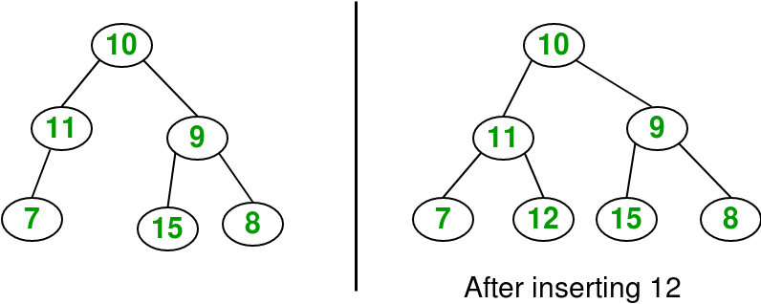
Example 2: Given a binary tree and a key, insert the key into the binary tree at the first position available in level order
.

Slide 12
Procedure
Deletion
1. Starting at the root, find the deepest and rightmost node in binary tree and node which we want to delete.
2. Replace the deepest rightmost node’s data with the node to be deleted.
3. Then delete the deepest rightmost node.

Slide 13
Example
Given a binary tree,
delete a node from it by making sure that tree shrinks from the bottom
(i.e. the deleted node is replaced by the bottom-most and rightmost node).
Here we do not have any order among elements, so we replace with the last element.

Slide 14
Example 2 :
Delete 20 in below tree
10
/ \
20 30
\
40
Output :
10
/ \
40 30
Example 1 :
Delete 10 in below tree
10
/ \
20 30
Output :
30
/
20

Slide 15
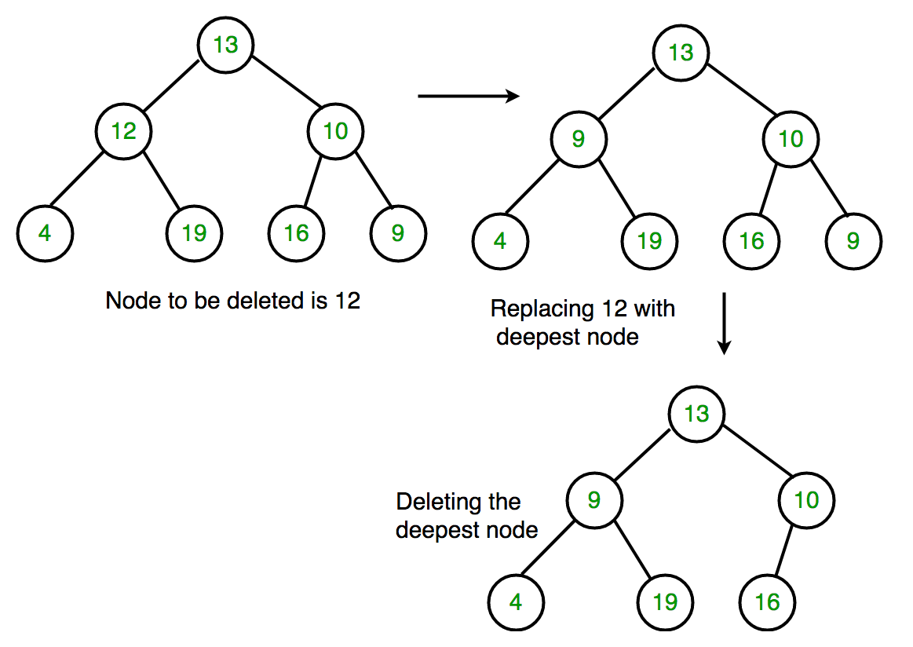
Example 3 :

Slide 16
Traversing
Continued……………in next ppt

