Slide 1
G.PULLAIAH COLLEGE OF ENGINEERING AND TECHNOLOGY (AUTONOMOUS)
Data Structures Using C
Unit-V
GRAPHS
By
P.Chandrakala
Assistant Professor
Department of Computer Science and Engineering

Slide 2
What is a graph?
Graph is a non-linear data structure. It contains a set of points known as nodes (or vertices) and a set of links known as edges (or Arcs). Here edges are used to connect the vertices.
Generally, a graph G is represented as G = ( V , E ), where V is set of vertices and E is set of edges.
Graph is a collection of vertices and arcs in which vertices are connected with arcs.
Graph is a collection of nodes and edges in which nodes are connected with edges.

Slide 3
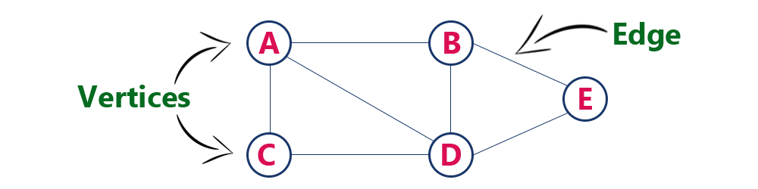
Example
The following is a graph with 5 vertices and 6 edges.
This graph G can be defined as G = ( V , E ), where
V = {A,B,C,D,E} and
E = {(A,B),(A,C)(A,D),(B,D),(C,D),(B,E),(E,D)}.

Slide 4
Graph Terminology
Vertex: Individual data element of a graph is called as vertex. Vertex is also known as node.
  In above example graph, A, B, C, D & E are known as vertices.
Edge: An edge is a connecting link between two vertices. Edge is also known as Arc. An edge is represented as (startingVertex, endingVertex).
  For example, in above graph the link between vertices A and B is represented as (A,B). In above example graph, there are 7 edges (i.e., (A,B), (A,C), (A,D), (B,D), (B,E), (C,D), (D,E)).
End vertices or Endpoints: The two vertices joined by edge are called end vertices (or endpoints) of that edge.
Origin: If an edge is directed, its first endpoint is said to be the origin of it.

Slide 5
Destination: If an edge is directed, its first endpoint is said to be the origin of it and the other endpoint is said to be the destination of that edge.
Adjacent: If there is an edge between vertices A and B then both A and B are said to be adjacent. In other words, vertices A and B are said to be adjacent if there is an edge between them.
Incident: Edge is said to be incident on a vertex if the vertex is one of the endpoints of that edge.
Outgoing Edge: A directed edge is said to be outgoing edge on its origin vertex.
Incoming Edge: A directed edge is said to be incoming edge on its destination vertex.

Slide 6
Degree: Total number of edges connected to a vertex is said to be degree of that vertex.
Indegree: Total number of incoming edges connected to a vertex is said to be indegree of that vertex.
Outdegree: Total number of outgoing edges connected to a vertex is said to be outdegree of that vertex.
Parallel edges or Multiple edges: If there are two undirected edges with same end vertices and two directed edges with same origin and destination, such edges are called parallel edges or multiple edges.
Self-loop: Edge (undirected or directed) is a self-loop if its two endpoints coincide with each other.
Path: A path is a sequence of alternate vertices and edges that starts at a vertex and ends at other vertex such that each edge is incident to its predecessor and successor vertex.

Slide 7
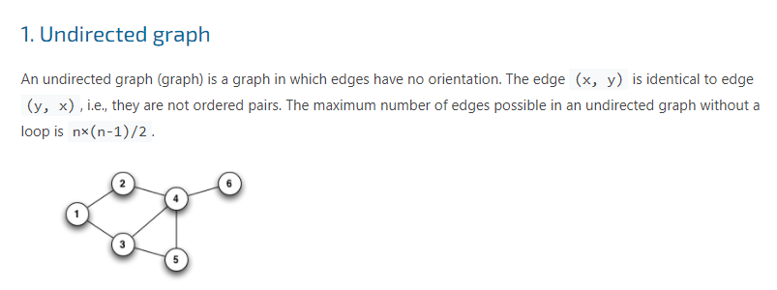
Types of Graph

Slide 8
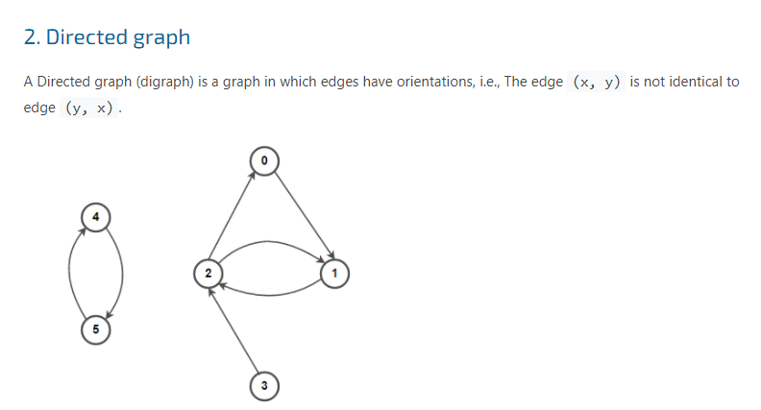

Slide 9
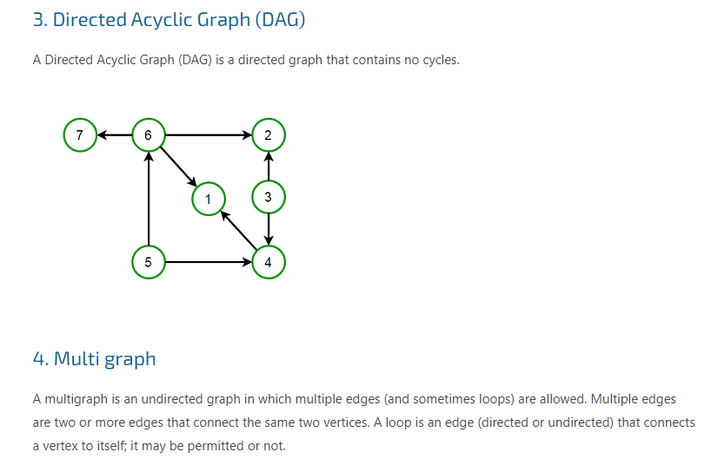

Slide 10
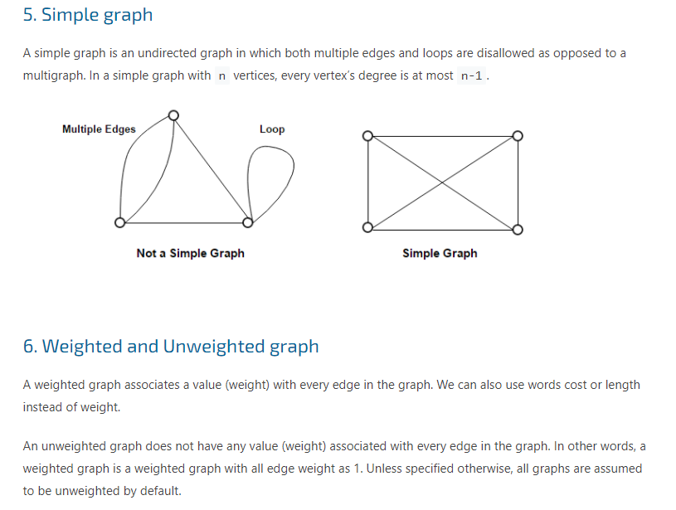

Slide 11
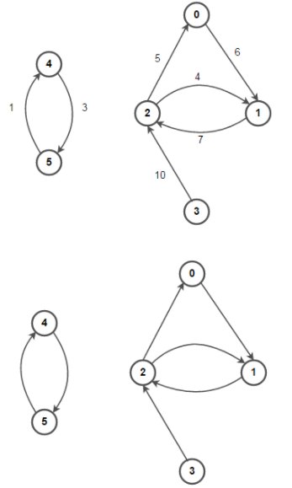

Slide 12
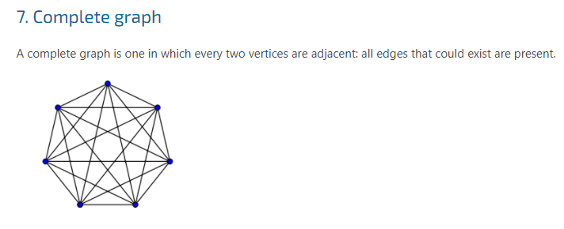
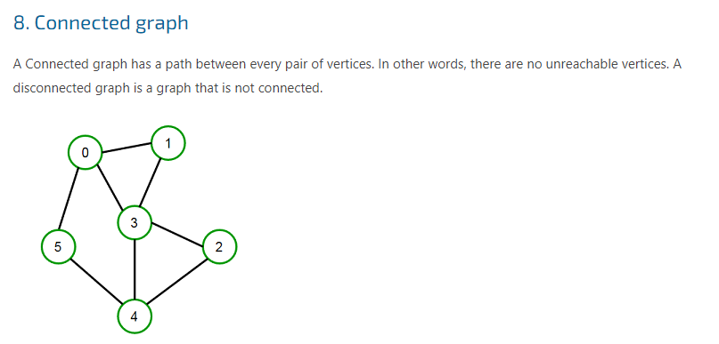

Slide 13
Graph Representations
Graph data structure is represented using following representations...
Adjacency Matrix
Incidence Matrix
Adjacency List

Slide 14
Adjacency Matrix
In this representation, the graph is represented using a matrix of size total number of vertices by a total number of vertices.
That means a graph with 4 vertices is represented using a matrix of size 4X4.
In this matrix, both rows and columns represent vertices. This matrix is filled with either 1 or 0.
Here, 1 represents that there is an edge from row vertex to column vertex and 0 represents that there is no edge from row vertex to column vertex.

Slide 15
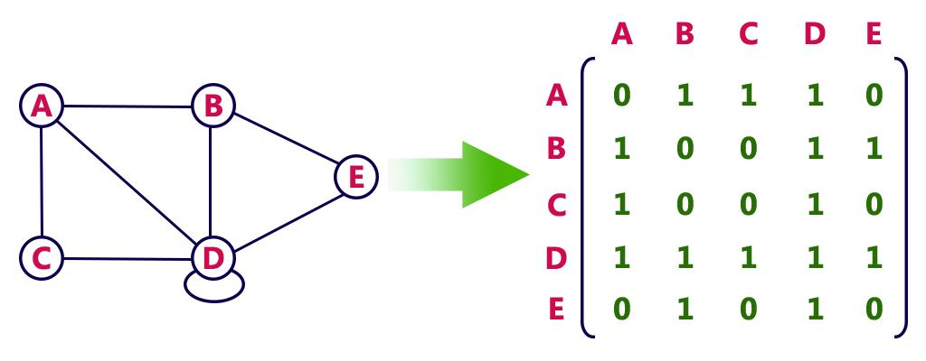
Example
Undirected graph representation...

Slide 16
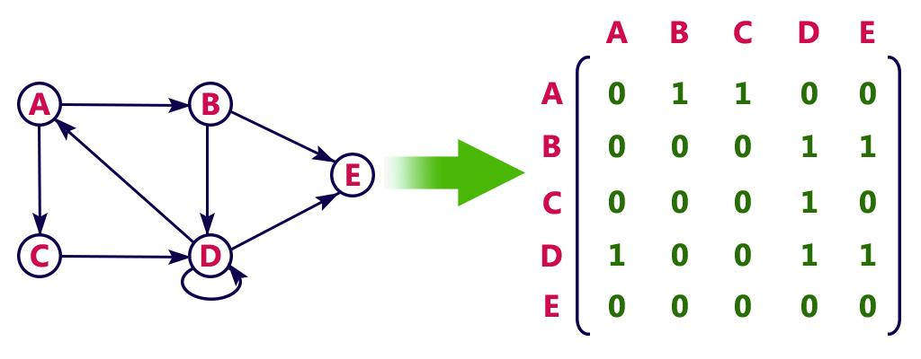
Directed graph representation...

Slide 17
Incidence Matrix
In this representation, the graph is represented using a matrix of size total number of vertices by a total number of edges.
That means graph with 4 vertices and 6 edges is represented using a matrix of size 4X6. In this matrix, rows represent vertices and columns represents edges.
This matrix is filled with 0 or 1 or -1.
Here, 0 represents that the row edge is not connected to column vertex, 1 represents that the row edge is connected as the outgoing edge to column vertex and -1 represents that the row edge is connected as the incoming edge to column vertex.

Slide 18
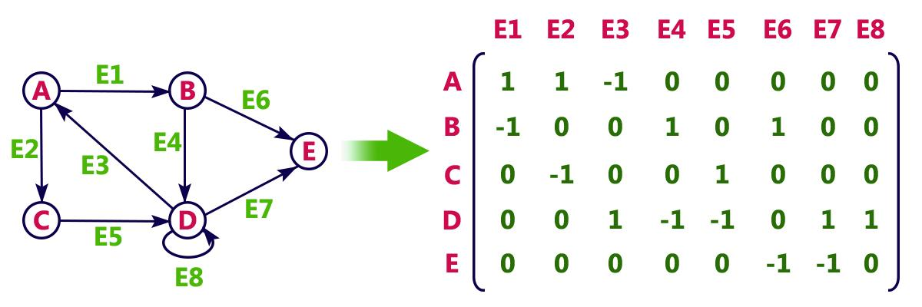
Example
Directed graph representation...

Slide 19
Adjacency List
In this representation, every vertex of a graph contains list of its adjacent vertices.
An adjacency list represents a graph as an array of linked lists.
The index of the array represents a vertex and each element in its linked list represents the other vertices that form an edge with the vertex.

Slide 20
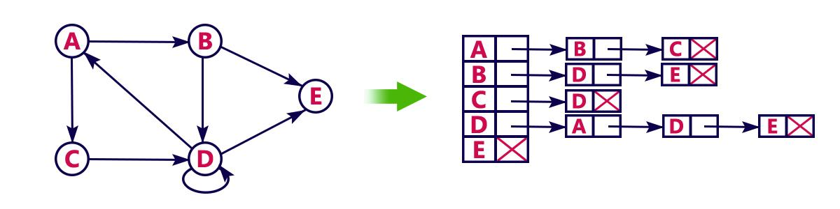
Example
Directed graph representation implemented using linked list...

Slide 21
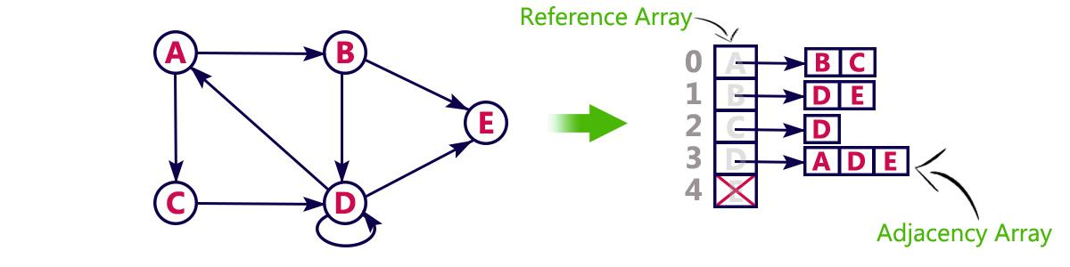
This representation can also be implemented using an array....

Slide 22
GRAPH TRAVERSALS
Graph traversal is a technique used for searching a vertex in a graph.
The graph traversal is also used to decide the order of vertices visited in the search process.
A graph traversal finds the edges to be used in the search process without creating loops.
That means using graph traversal we visit all the vertices of the graph without getting into looping path.
There are two graph traversal techniques and they are as follows...
BFS (Breadth First Search)
DFS (Depth First Search)

Slide 23
BFS (Breadth First Search)
BFS traversal of a graph produces a spanning tree as final result.
Spanning Tree is a graph without loops.
We use Queue data structure with maximum size of total number of vertices in the graph to implement BFS traversal.

Slide 24
Procedure
Step 1 - Define a Queue of size total number of vertices in the graph.
Step 2 - Select any vertex as starting point for traversal. Visit that vertex and insert it into the Queue.
Step 3 - Visit all the non-visited adjacent vertices of the vertex which is at front of the Queue and insert them into the Queue.
Step 4 - When there is no new vertex to be visited from the vertex which is at front of the Queue then delete that vertex.
Step 5 - Repeat steps 3 and 4 until queue becomes empty.
Step 6 - When queue becomes empty, then produce final spanning tree by removing unused edges from the graph

Slide 25
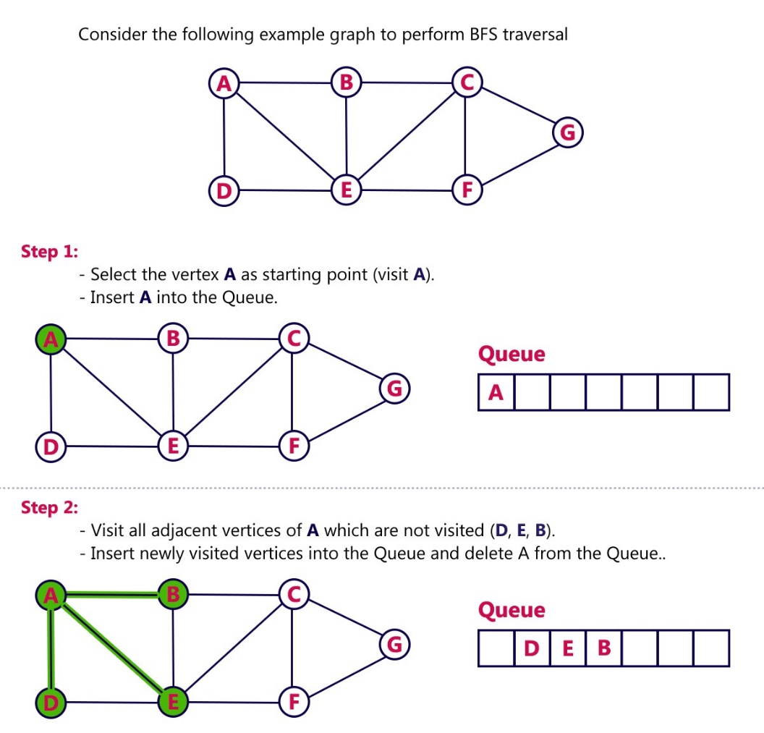

Slide 26
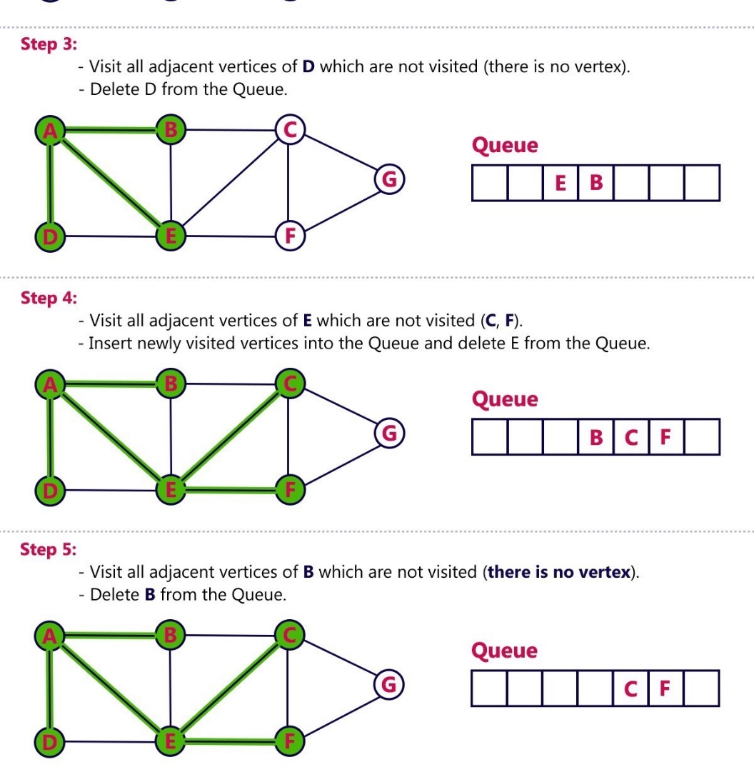

Slide 27
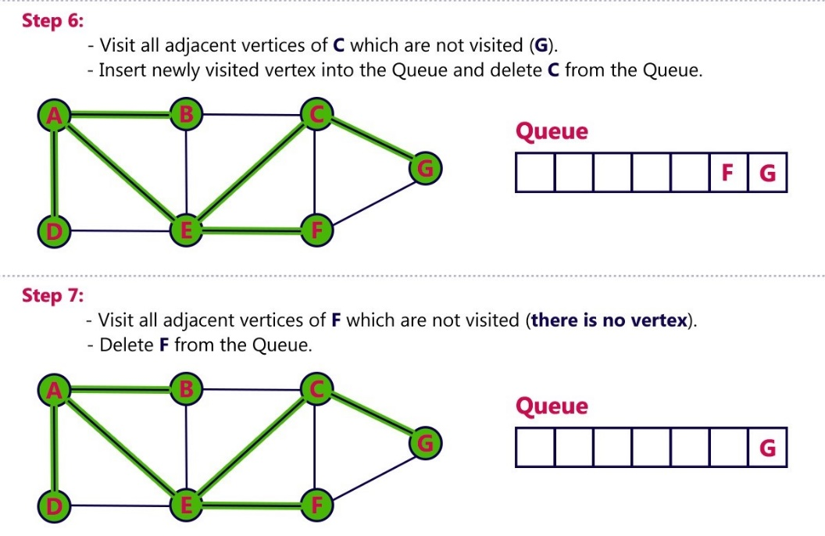

Slide 28
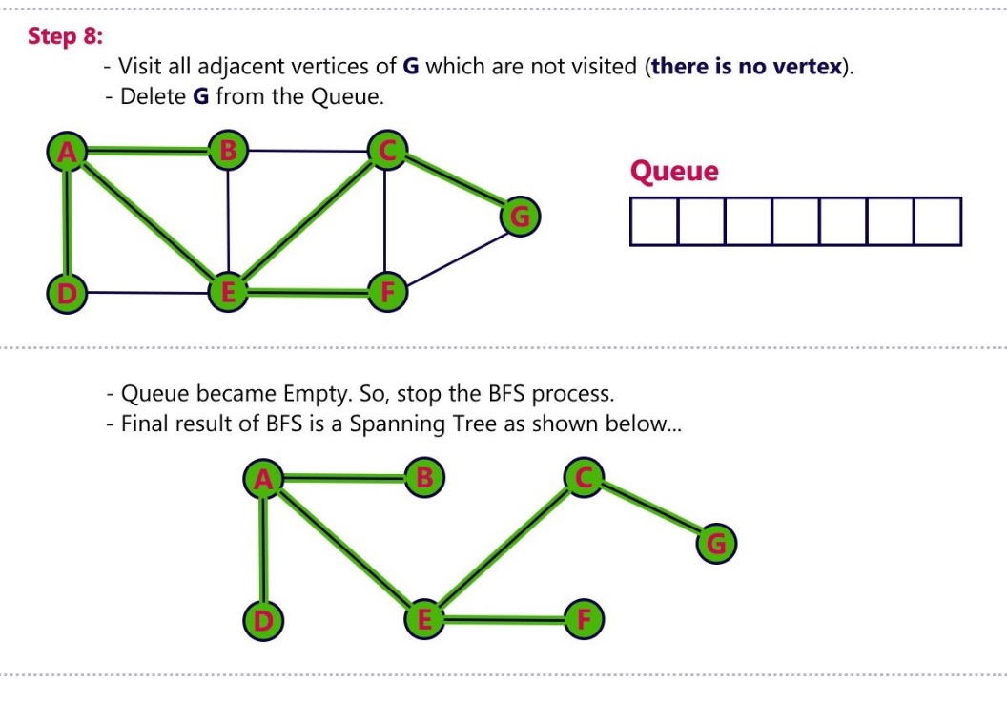

Slide 29
DFS (Depth First Search)
DFS traversal of a graph produces a spanning tree as final result.
Spanning Tree is a graph without loops.
We use Stack data structure with maximum size of total number of vertices in the graph to implement DFS traversal.

Slide 30
Procedure
Step 1 - Define a Stack of size total number of vertices in the graph.
Step 2 - Select any vertex as starting point for traversal. Visit that vertex and push it on to the Stack.
Step 3 - Visit any one of the non-visited adjacent vertices of a vertex which is at the top of stack and push it on to the stack.
Step 4 - Repeat step 3 until there is no new vertex to be visited from the vertex which is at the top of the stack.
Step 5 - When there is no new vertex to visit then use back tracking and pop one vertex from the stack.
Step 6 - Repeat steps 3, 4 and 5 until stack becomes Empty.
Step 7 - When stack becomes Empty, then produce final spanning tree by removing unused edges from the graph.
Back tracking is coming back to the vertex from which we reached the current vertex.

Slide 31
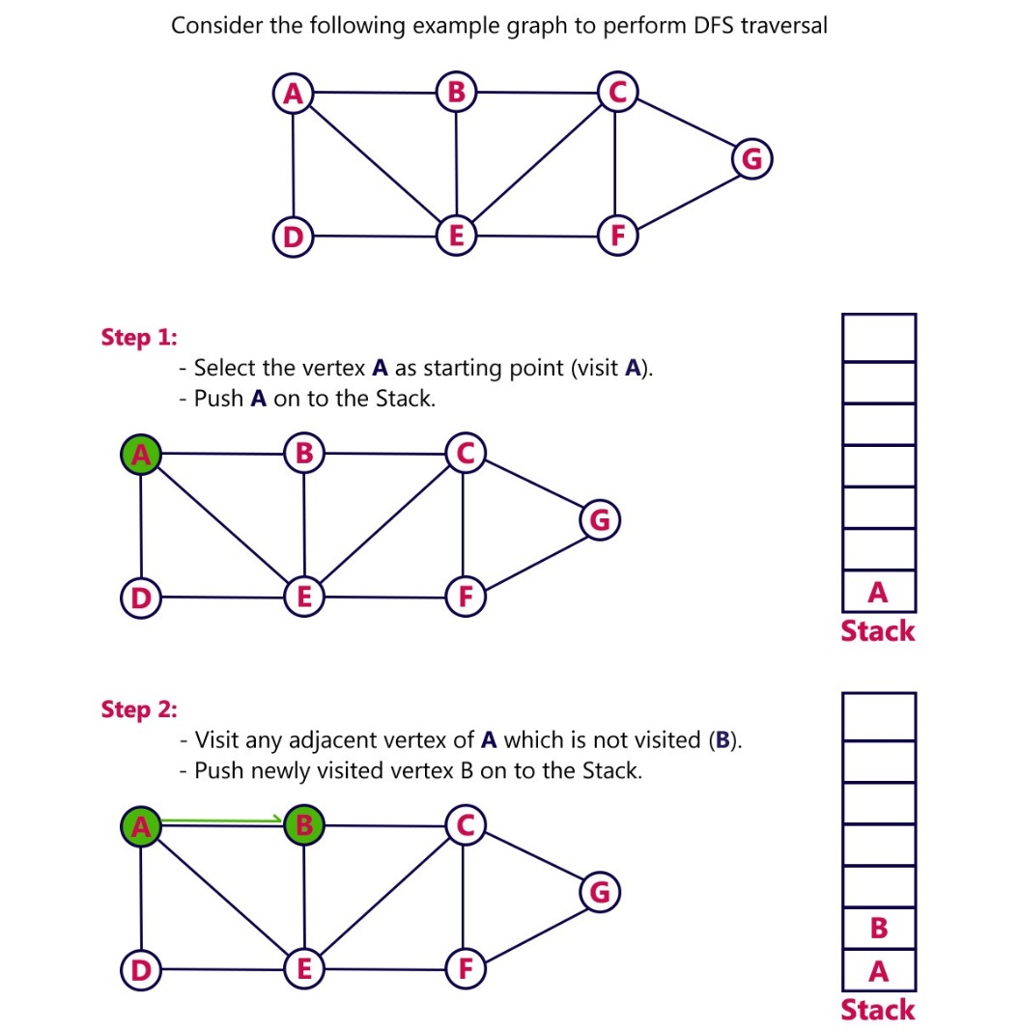

Slide 32
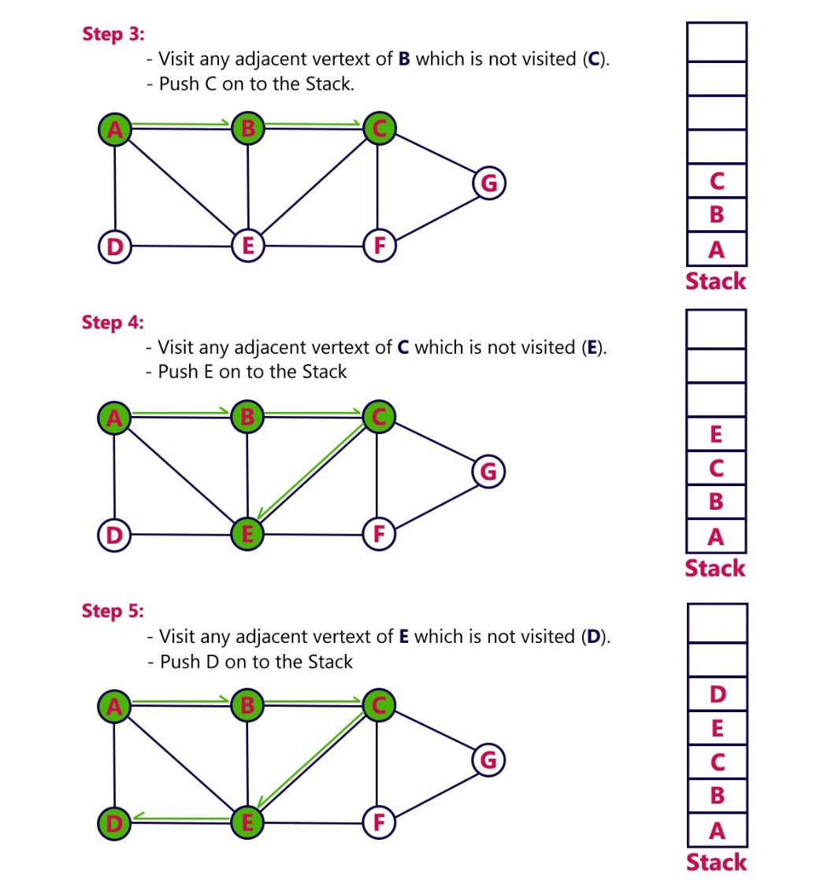

Slide 33
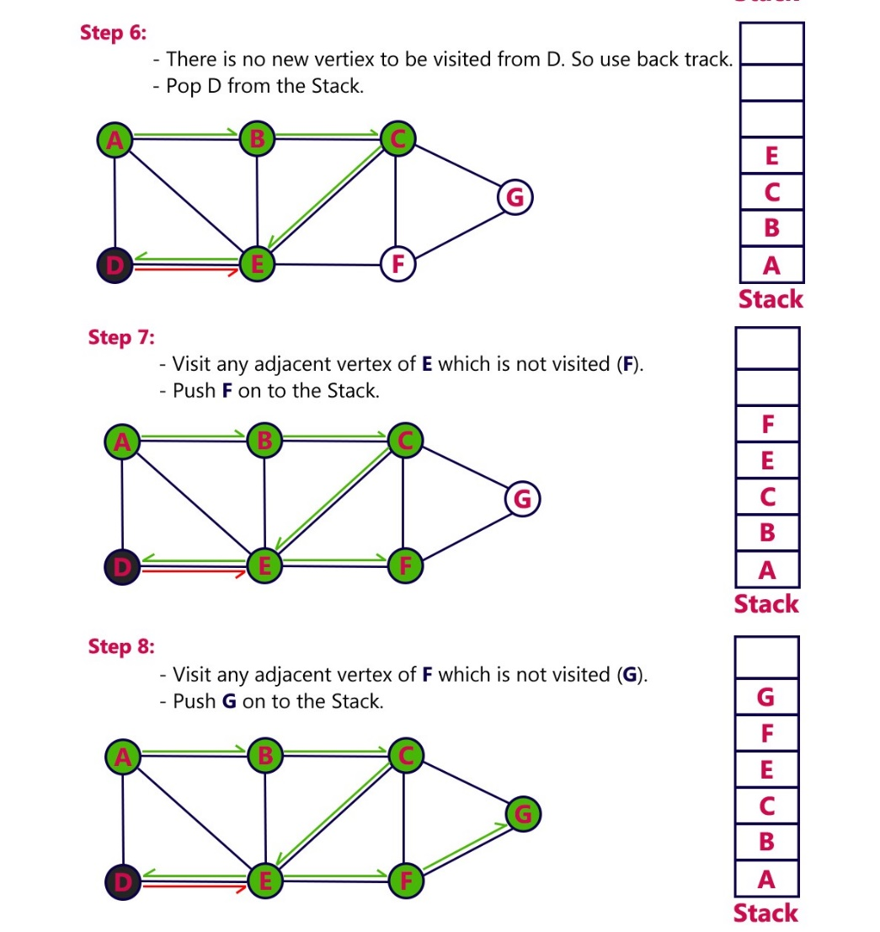

Slide 34
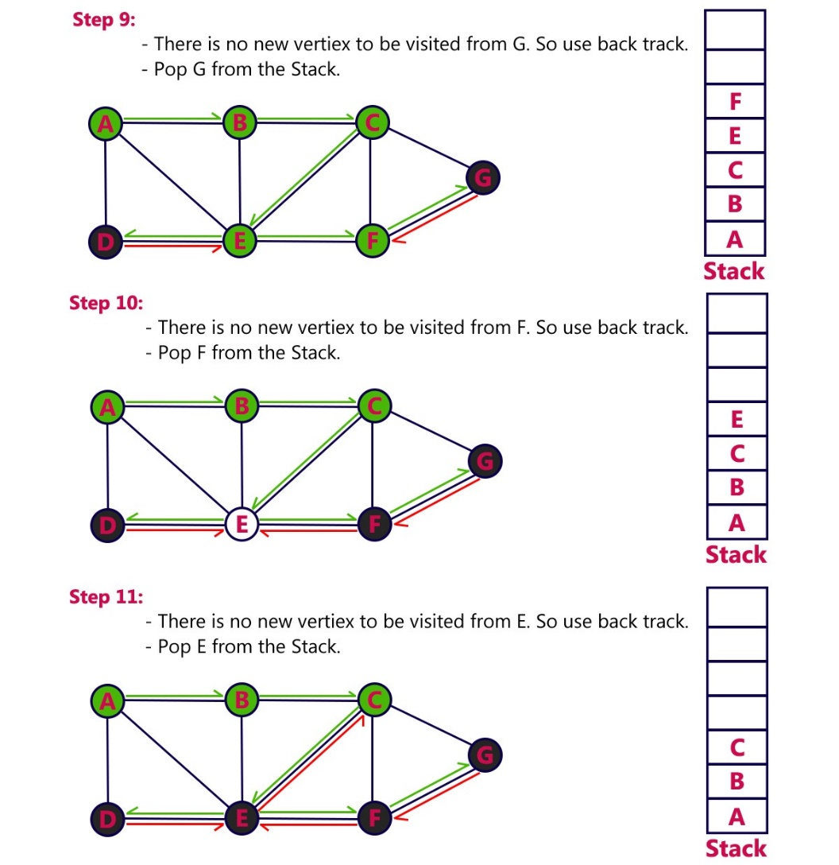

Slide 35
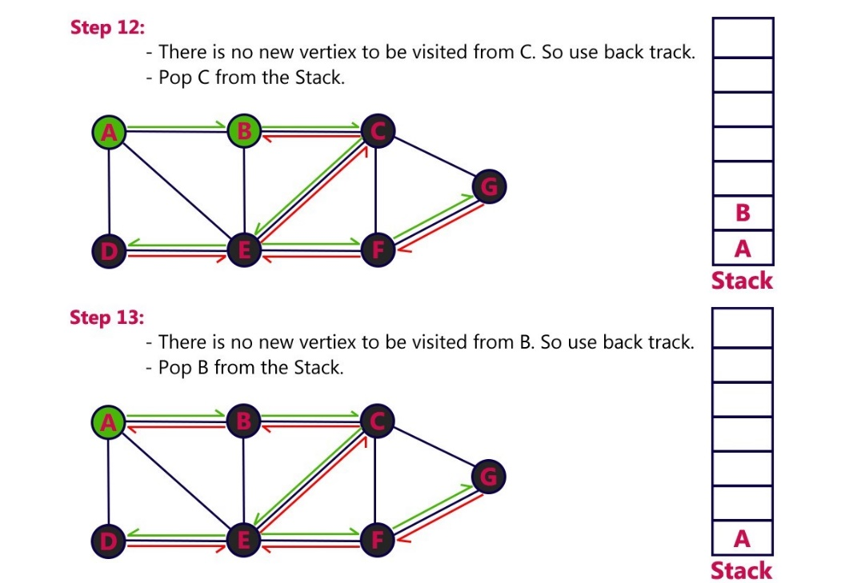

Slide 36
